Slide 1


Goal Setting
Presented by J.W. Owens
A Perspective 101 Series
JWO 234
Notes:
To replace this picture, just select and delete it. Then use the Insert Picture icon to replace it with one of your own!

Slide 2
Goal Setting
I will take responsibility for my own life.
I will set my own course.
I will make my own success.
I will take action.
I will persist.
I will find lessons in setbacks.

Slide 3
Goal Setting
I will look forward not backward.
I will turn my haters into motivators.
I will be empowered by my circumstances not impeded by them.
I will do the things others are unwilling to do.
I will make no more excuses!”

Slide 4
Goal Setting
What Do You Want?
You want something. You have goals. You have dreams.
The reason I know that you have dreams and goals is that as a high achiever it’s just in your nature.
As individuals our goals and dreams are unique.
For some what you want can be complex and for others extremely simple.
What matters most is that you find a way to get what you want, and that you leverage your talents to make your dreams come true.
What’s sad to me, is how few of us actually take time to think about what we really want.
But a serious conversation with ourselves during which we make tough, clear decisions about what is most important, what dreams are priorities, what goals we must achieve, and what really motivates us in life.

Slide 5
Goal Setting
When I ask this simple question,
“What do you want?”
the answers most often returned are:
“I just want to be happy” or “I want to be successful.”
Most people say that they want to be the best on their team and win the respect of their peers - often without defining what that means and the steps they’ll have to take to be “the best”.
Some people just say “I don’t know”, which is an honest answer though not the optimal way to journey through life.

Slide 6
Goal Setting
So I dig a little deeper and ask questions like,
“What does happy mean to you?”,
“How do you define success?” or
“How will you become the #1 person on your team?”
The subsequent blank stare tells me we have a lot of work to do.
Defining what you want will not be easy. It will take practice and patience.
Get some help from your significant other, your friends, manager or a coach; they can provide you with perspective and feedback that will help you be honest with yourself.
Of course, the most important thing you can do is start!

Slide 7
Goal Setting
A written goal
is motivation’s playing field.
When you write down your goals you turn energy into action.
Action is motion.
Motion creates momentum.
Momentum moves you forward towards your dreams.

Slide 8
The first, and most important,
Step towards getting what you want is to define it and write it down.
Unfortunately, this simple step has been over-complicated by many goal setting gurus.
My point is, in the span of fifteen minutes you can set five to ten key goals for the next year.
In the course of an hour, day or a week you can set goals for the next three, five or ten years.
Invest an hour or so a month to review, rewrite or set new goals and you will change your life. It really is this simple.
Don’t over-complicate it…Define it and write it down!

Slide 9
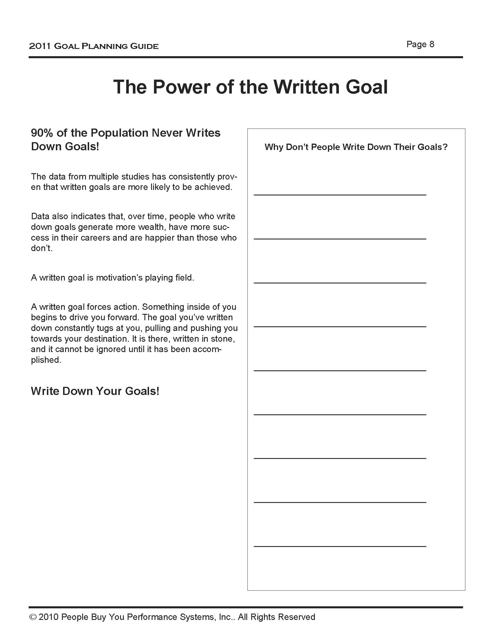
Goal Setting
90% of the Population Never Writes
Down Goals!
Write Down Your Goals!

Slide 10
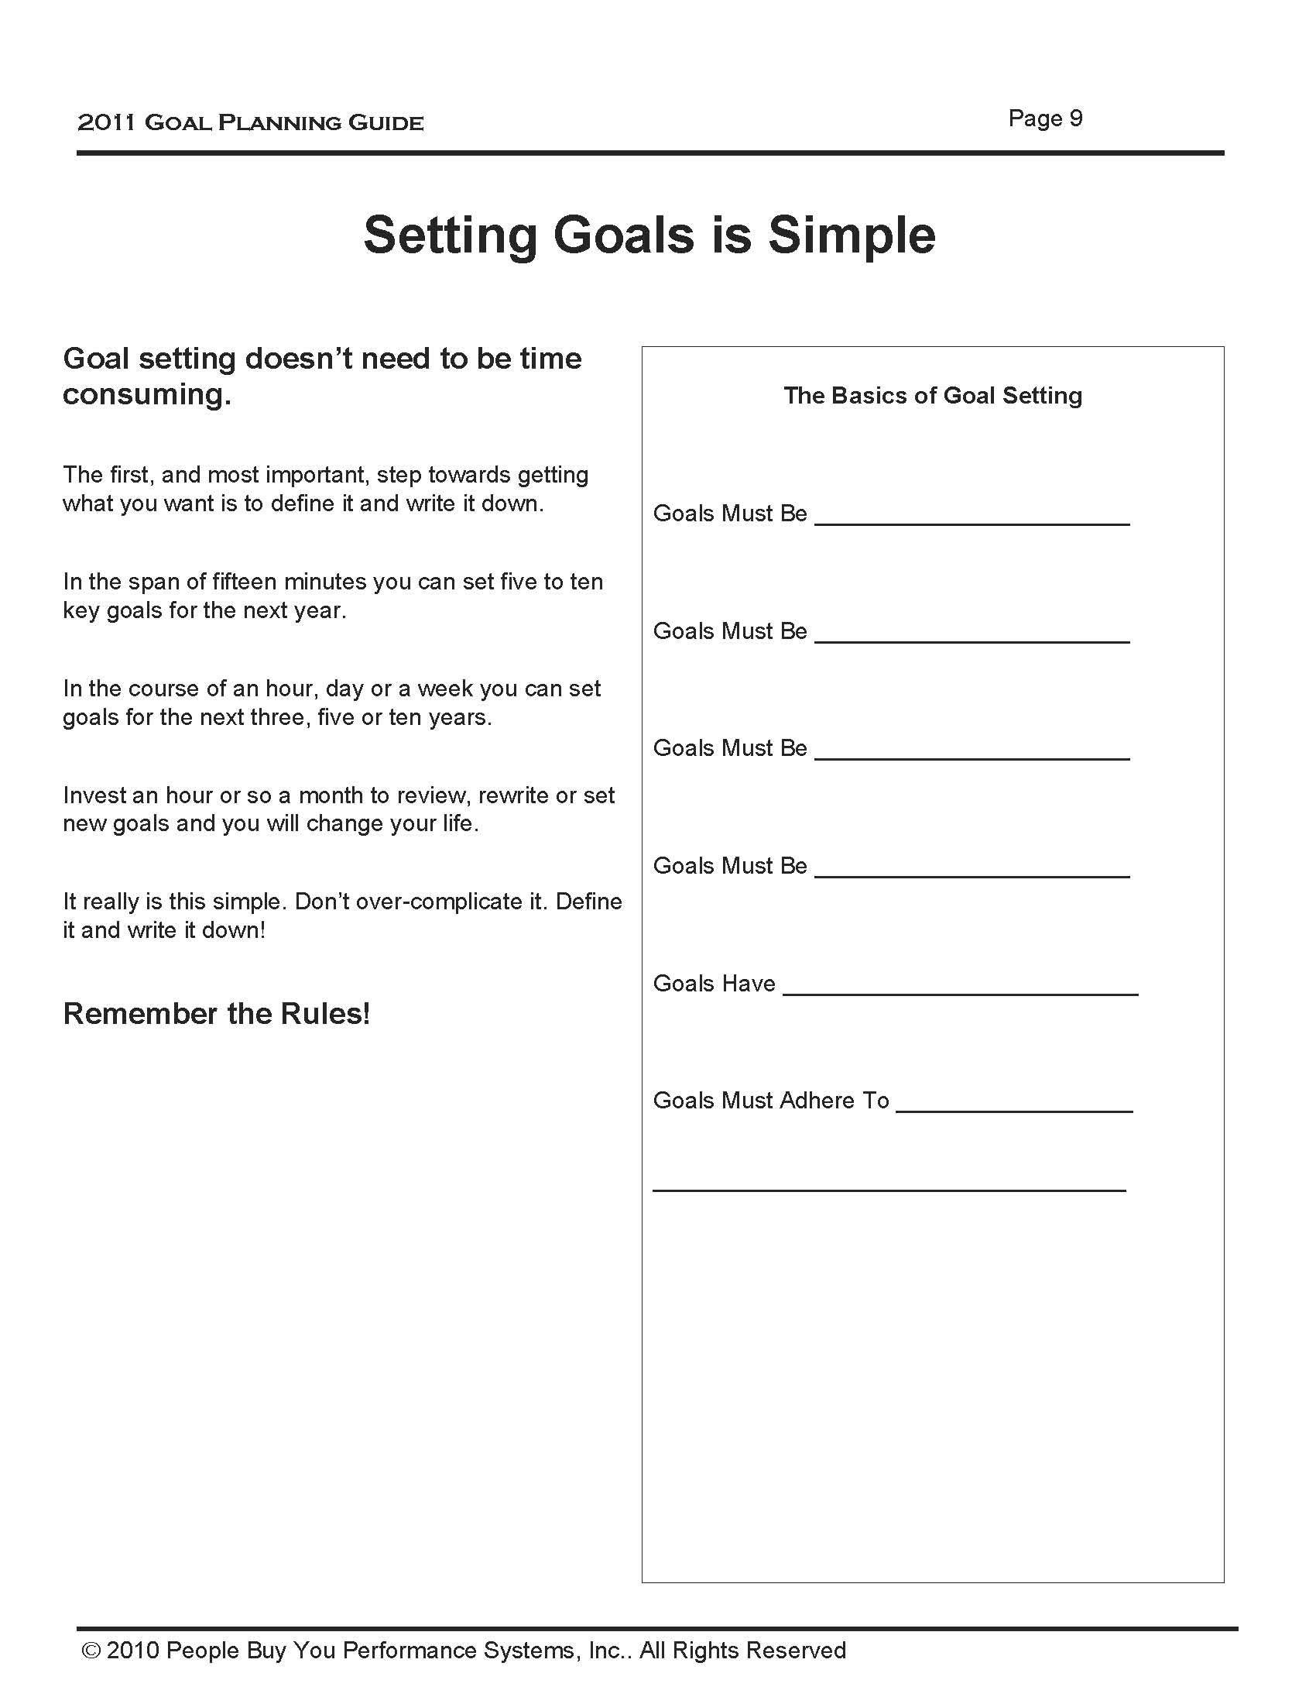
Goal Setting
Goal setting doesn’t need to be time consuming.
The first, and most important, step towards getting what you want is to define it and write it down.
Remember the Rules!

Slide 11
Goal Setting
Setting Goals Is Simple
There are a few basic rules you should follow when writing down your goals:
Goals Must be Specific,
Goals Must be Time Bound,
Goals Must be Attainable and of course,
Goals Must be Written Down.
It is important to shoot for the stars and ignore the limits, but if too many of your goals are long shots you’ll end up becoming frustrated.
Getting regular wins helps you stay motivated and on track.
Most importantly, big goals are always achieved through a series of small, measurable steps, and these Steps to Success (your plan) must be defined in the same manner.
Goal Sheet which is designed to help you with this process.

Slide 12
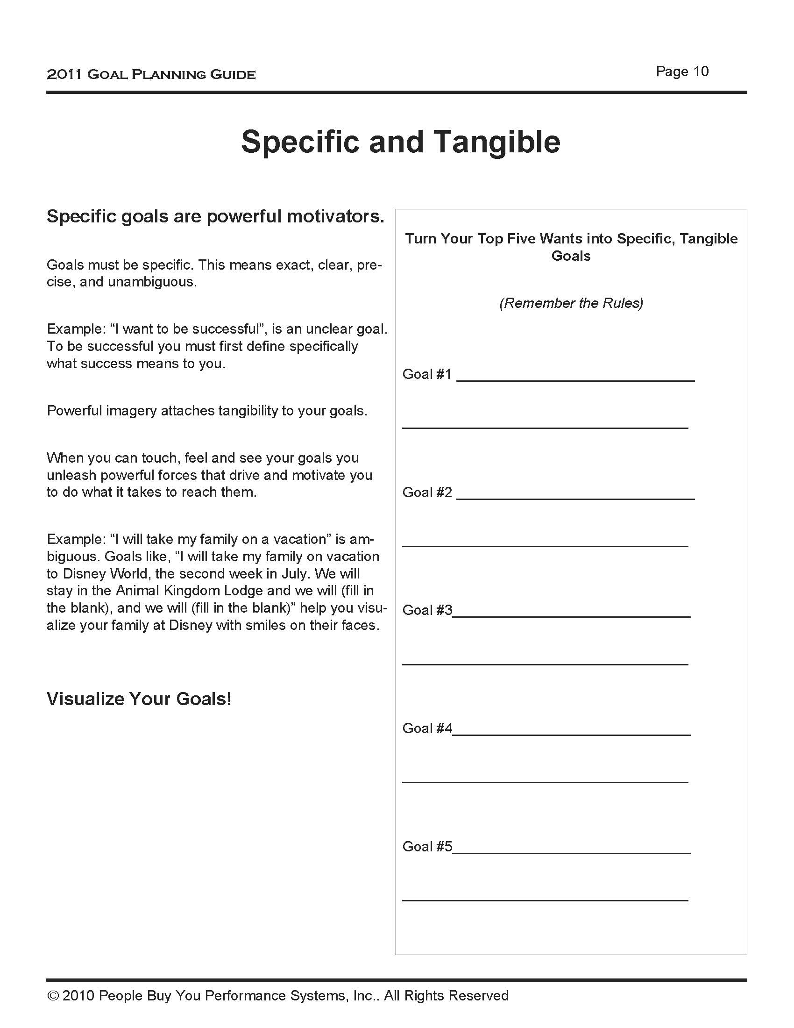
Goal Setting
Specific goals are powerful motivators.
Goals must be specific.
This means exact, clear, precise, and unambiguous.
Visualize Your Goals!

Slide 13
Goal Setting
Goals Must Be Specific
This means exact, clear, precise, and unambiguous.
For example, if you want to be successful, you will never have success until you define specifically what success means to you.
It takes work to be unambiguous with your goals. Sometimes it makes sense to have someone coach you.
When I help Sales Professionals define what they want and set specific goals,
a typical conversation goes something like this:

Slide 14
Goal Setting
Me: So tell me what you want.
Pro: Huh?
Me: What do you want out of your life?
Pro: Oh. I don’t know. I guess to be happy.
Me: That’s awesome. What does that mean, you know, to be happy?
Pro: Well, I guess I just want to be content.
Me: Okay. So help me out here. Tell me what it means to be content.
Pro: (Blank stare – silence)
Me: (Stares back – silence)
Pro: What do you mean?

Slide 15
Goal Setting
Me: Give me an example of what content means to you.
Pro: Well for one thing it means I don’t have to worry about money.
Me: How do you mean?
Pro: One of the things I worry about now is buying a home. I rent an apartment and I want to own my own home. To do that I need to have a down payment and I’m trying really hard to save.
Me: So are you saying that to feel happy and content you need to own your own home?

Slide 16
Goal Setting
Pro: Yes, when you put it that way I guess you are right. I think about this all of the time and I worry about how I’m going to get the down payment I need to buy the house I want.
Me: OK, is there anything else?
Pro: Yes, there are other things but owning my own home is the main thing. I really want that bad.
Me: Excellent. May I ask a question?
Pro: Sure.
Me: What kind of house do you want to own?
Pro: Oh I don’t know – just a house of my own.

Slide 17
Goal Setting
Me: Pro, I’m sure you’ve closed your eyes and dreamed. What does this house look like when you dream?
Pro: (he/she smiles) Well, it is a stucco house with a natural stone façade. They are building them in a new neighborhood called Riverchase.
Me: That sounds awesome. Tell me more.
Pro: Well I want it to have three bedrooms and a den I can use as an office and I want a granite kitchen with stainless steel appliances.
Me: It sounds like you’ve given this some thought.

Slide 18
Goal Setting
Pro: (Big smile) I guess I have. I really want this place.
Me: (pull out a Goal Sheet)
Let’s get to work on getting you that house!

Slide 19
Goal Setting
Make Goals Tangible
This is how people define what they want.
The key is helping them move from general wants to specific, tangible goals. With some practice you can learn how to frame questions like these for yourself.
Specific goals are powerful motivators.
When you take time to set and write down goals you naturally begin to visualize the outcome.
The Goal, “I will take my family on a vacation” is ambiguous.
Goals like, “I will take my family on vacation to Disney World, the second week in July. We will stay in the Animal Kingdom Lodge and we will (fill in the blank), and we will (fill in the blank)” help you visualize your family at Disney with smiles on their faces.
Powerful imagery attaches tangibility to your goals. When you can touch, feel and see your goals you unleash powerful forces that drive and motivate you to do what it takes to reach them.

Slide 20
Goal Setting
Goals Must Be Time Bound
Once you have defined exactly what you want, the next question that must be answered is “When?”
The act of defining “when” places urgency on your actions. Urgency is critical to achieving both long-term and short-term goals.
With long-term goals, urgency forces you to focus on the little steps that lead to the larger goal. With short-term goals, urgency forces action, harnessing your desire, to remove complacency and procrastination.
Defining “when” also keeps you realistic about the work you have to do to obtain your goals. If you are unrealistic about the amount of time it will take to reach your goals you may end up frustrated or dejected. Of course, there is always the chance that you push your deadlines so far out into the future that you fail to reach your full potential, and end up with less than you could have had.

Slide 21
Goal Setting
Goals Must Be Written Down
When you write down your goals, ink on paper, you tap into a powerful force.
This same force is not present when you just think about your goals. It only comes into play when you write them down.
A written goal forces action. Something inside of you begins to drive you forward. The goal you’ve written down constantly tugs at you, pulling and pushing you towards your destination. It is there, written in stone, and it cannot be ignored until it has been accomplished.

Slide 22
Goal Setting
Goals Must Be Written Down
Writing down goals is risky business, which is why so few people actually do it…
What’s the risk?
You risk failure. The fear of falling on your face keeps you from committing. Then there is the work involved. That can be risky, too. When you write down your goals, action becomes a requirement.
Action is work and subconsciously we would rather rest on easy street. Stepping out of our comfort zone is scary. But, oh, how the world will open up to you once you take that step!

Slide 23
Goal Setting
Steps to Success
Once you’ve defined your specific goals and committed to a realistic time line, you’ll want to develop an action plan.
An excellent way to capture these Steps to Success in written form is to use the Goal Sheet has three parts.
1. My Goals: specific and attainable
2. My Deadline: time bound
3. My Steps to Success: measurable plan

Slide 24
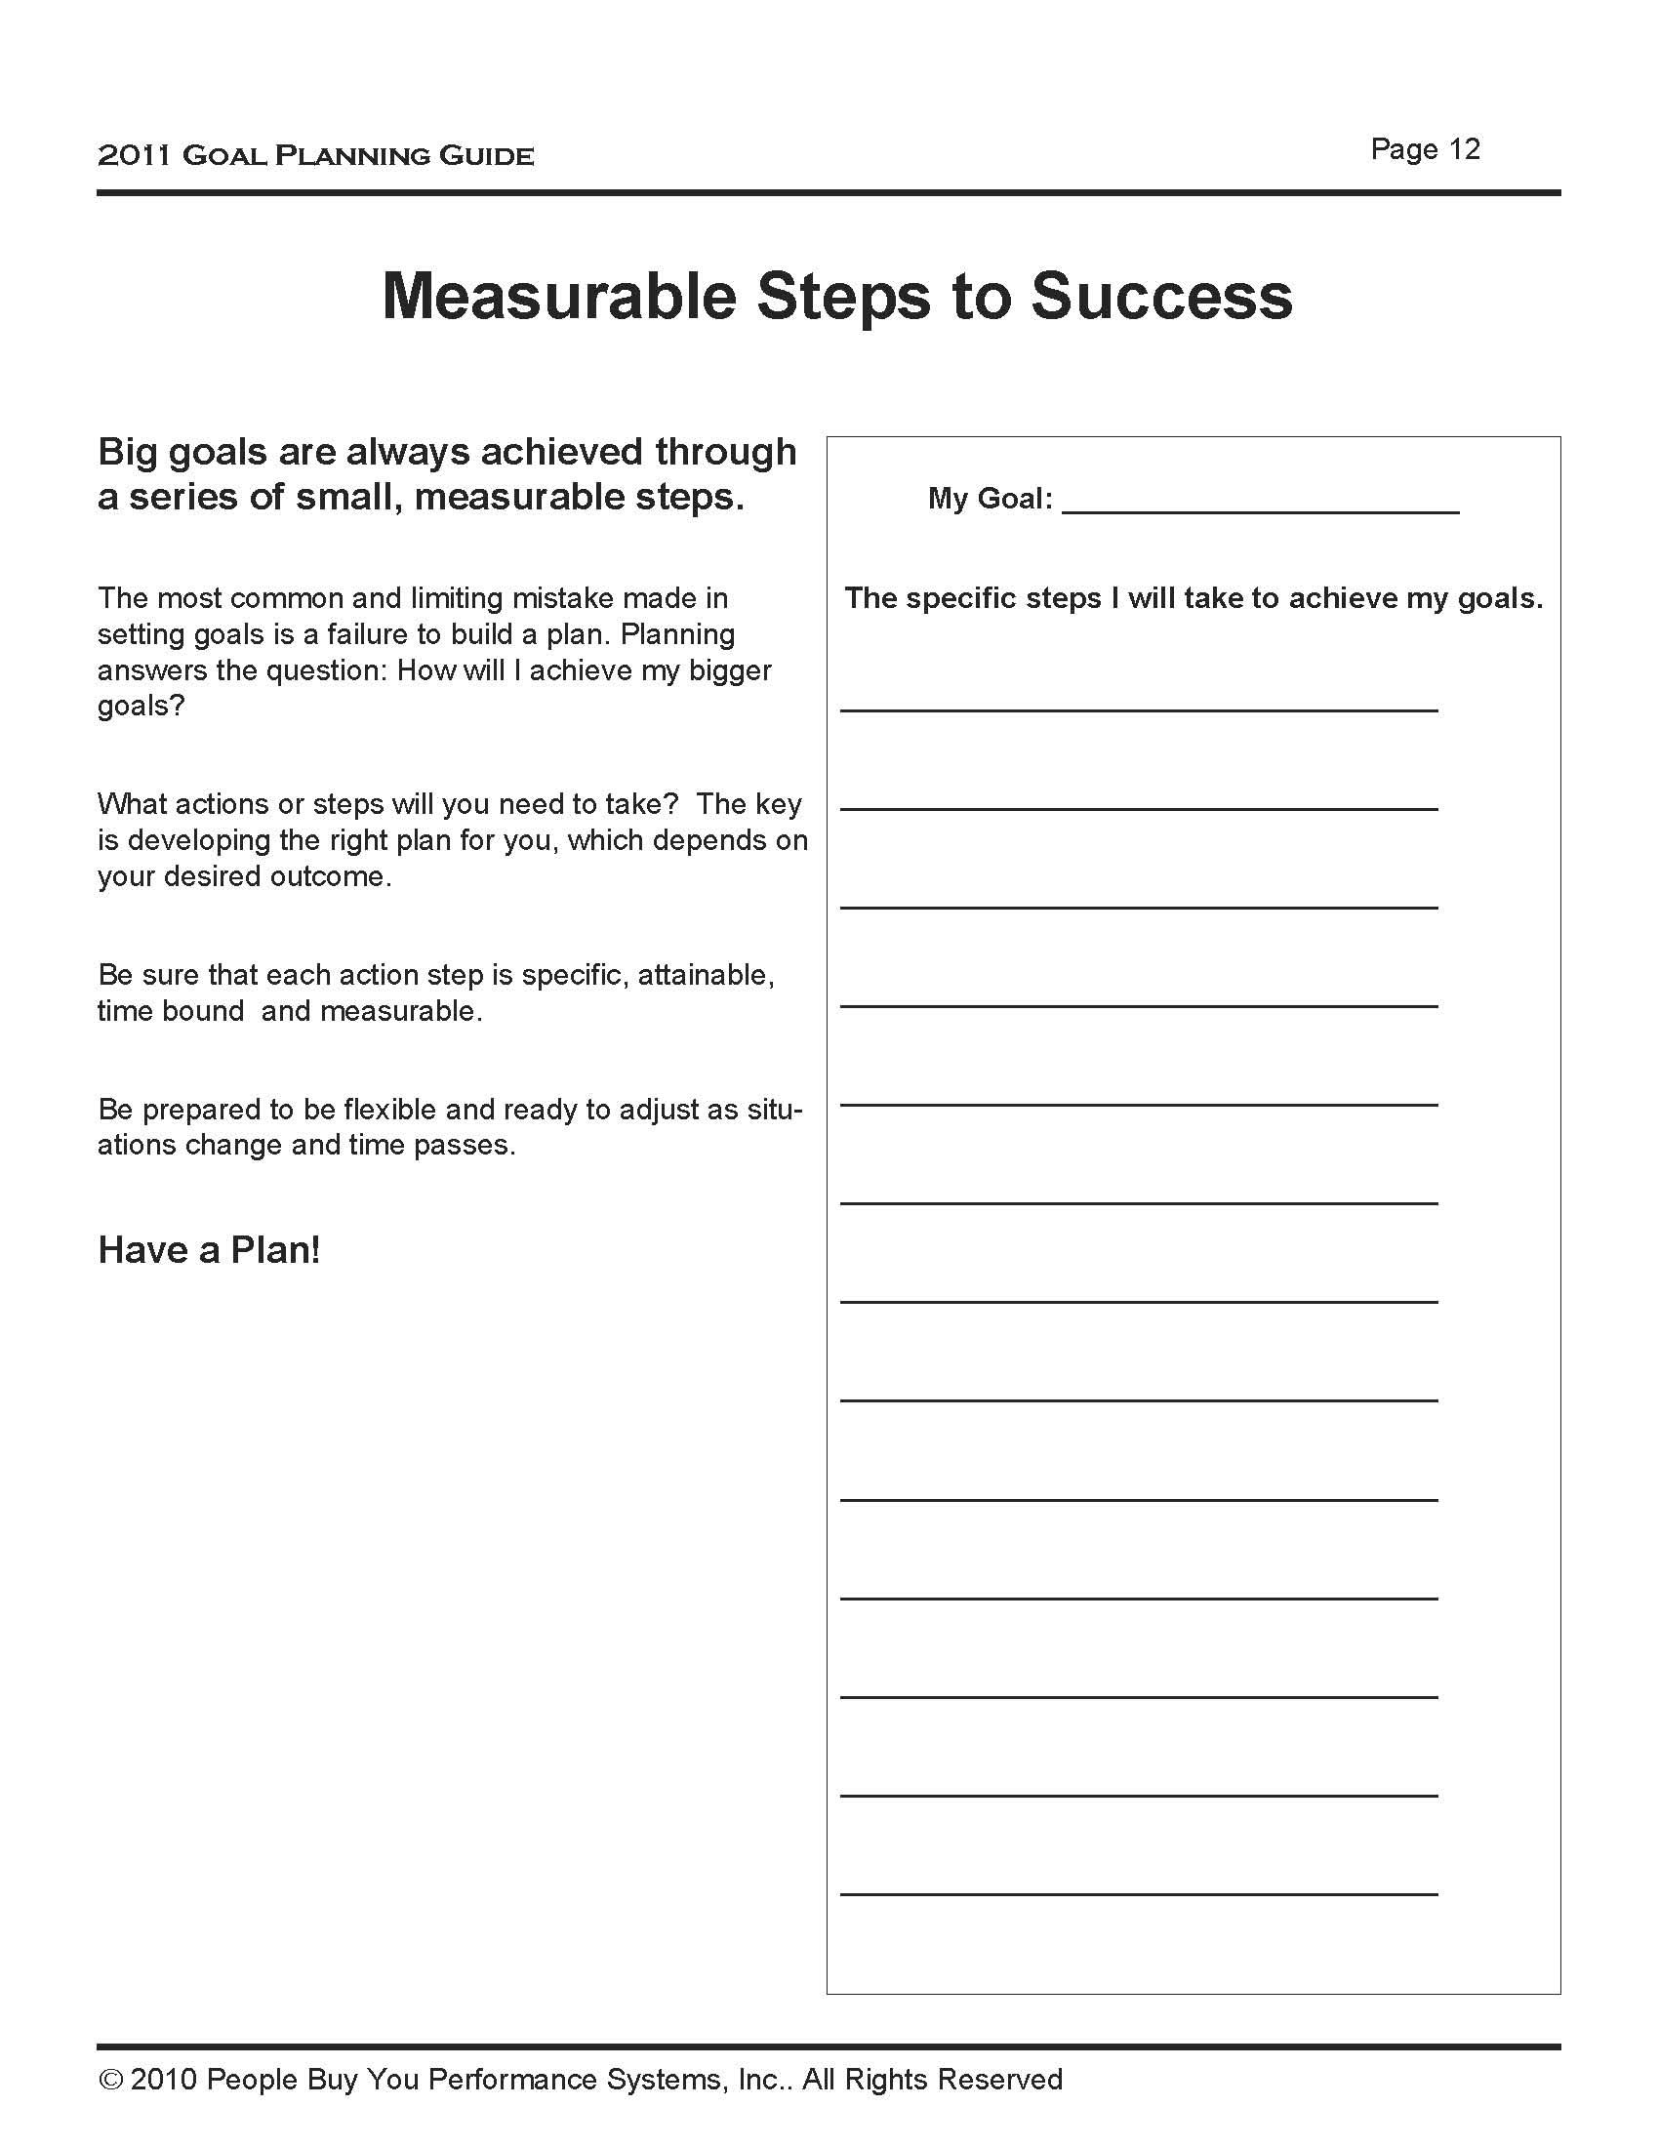
Goal Setting
Big goals are always achieved through
a series of small, measurable steps.
Have a Plan!

Slide 25
Goal Setting
The most common and limiting mistake people make in setting goals is a failure to build a plan.
In sales, the Steps are straight forward because they are almost always defined in terms of measurable sales activities.
Typically these activities include things like the number of cold calls (by phone and in person), referrals, networking events, first time visits, return visits, proposals or presentations.
There are also levers like the size of the deals you sell, product mix, re-orders, gross margins, etc...
There are endless combinations.
The trick is to develop the right plan for you, which depends on your desired outcome and industry.
Be prepared to be flexible and ready to adjust as situations change and time passes.

Slide 26
Goal Setting
The Law of Congruency
Often, we are more than willing to set a goal but unwilling to do the work required.
The price for our goal is just too high for us, and sometimes with good reason. If, for instance, you want to be a Sales Manager, which means you must sacrifice many nights away from your family and take a potential income reduction; perhaps the price is too high and you should choose a goal more congruent with your values.
Wasting time on unattainable goals impedes your progress leaving you both frustrated and feeling like a failure.
Your awareness that goals and actions must be congruent will lead you to become more realistic about the price it will cost you to attain your goals.
A dose of reality will help you build better Steps and shore up the self discipline you will need to be successful.

Slide 27
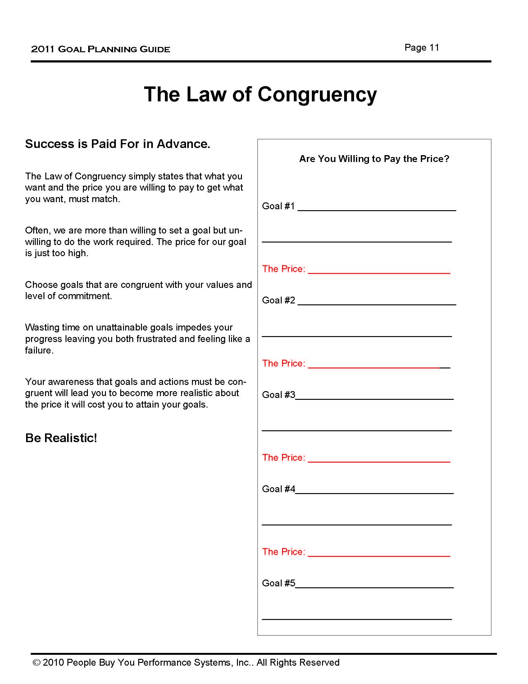
Goal Setting
Success is Paid For in Advance.
The Law of Congruency simply states that what you want and the price you are willing to pay to get what you want, must match.
Be Realistic!

Slide 28
Goal Setting
Start Now!
Define what you want and write it down.
It isn’t much more complicated than this.
Take action now.
This goals planning guide is designed to walk you through the goal setting process.
However, it is useless if you don’t use it. Once you define what you want and write it down, with some work, you will begin reaping the rewards you deserve from your sales career.
Start Now!

Slide 29
Goal Setting
90% of the Population Never Writes Down Goals!
The data from multiple studies has consistently proven that written goals are more likely to be achieved.
Data also indicates that, over time, people who write down goals generate more wealth, have more success in their careers and are happier than those who don’t.
A written goal is motivation’s playing field.
A written goal forces action. Something inside of you begins to drive you forward. The goal you’ve written down constantly tugs at you, pulling and pushing you towards your destination. It is there, written in stone, and it cannot be ignored until it has been accomplished.
Write Down Your Goals!

Slide 30
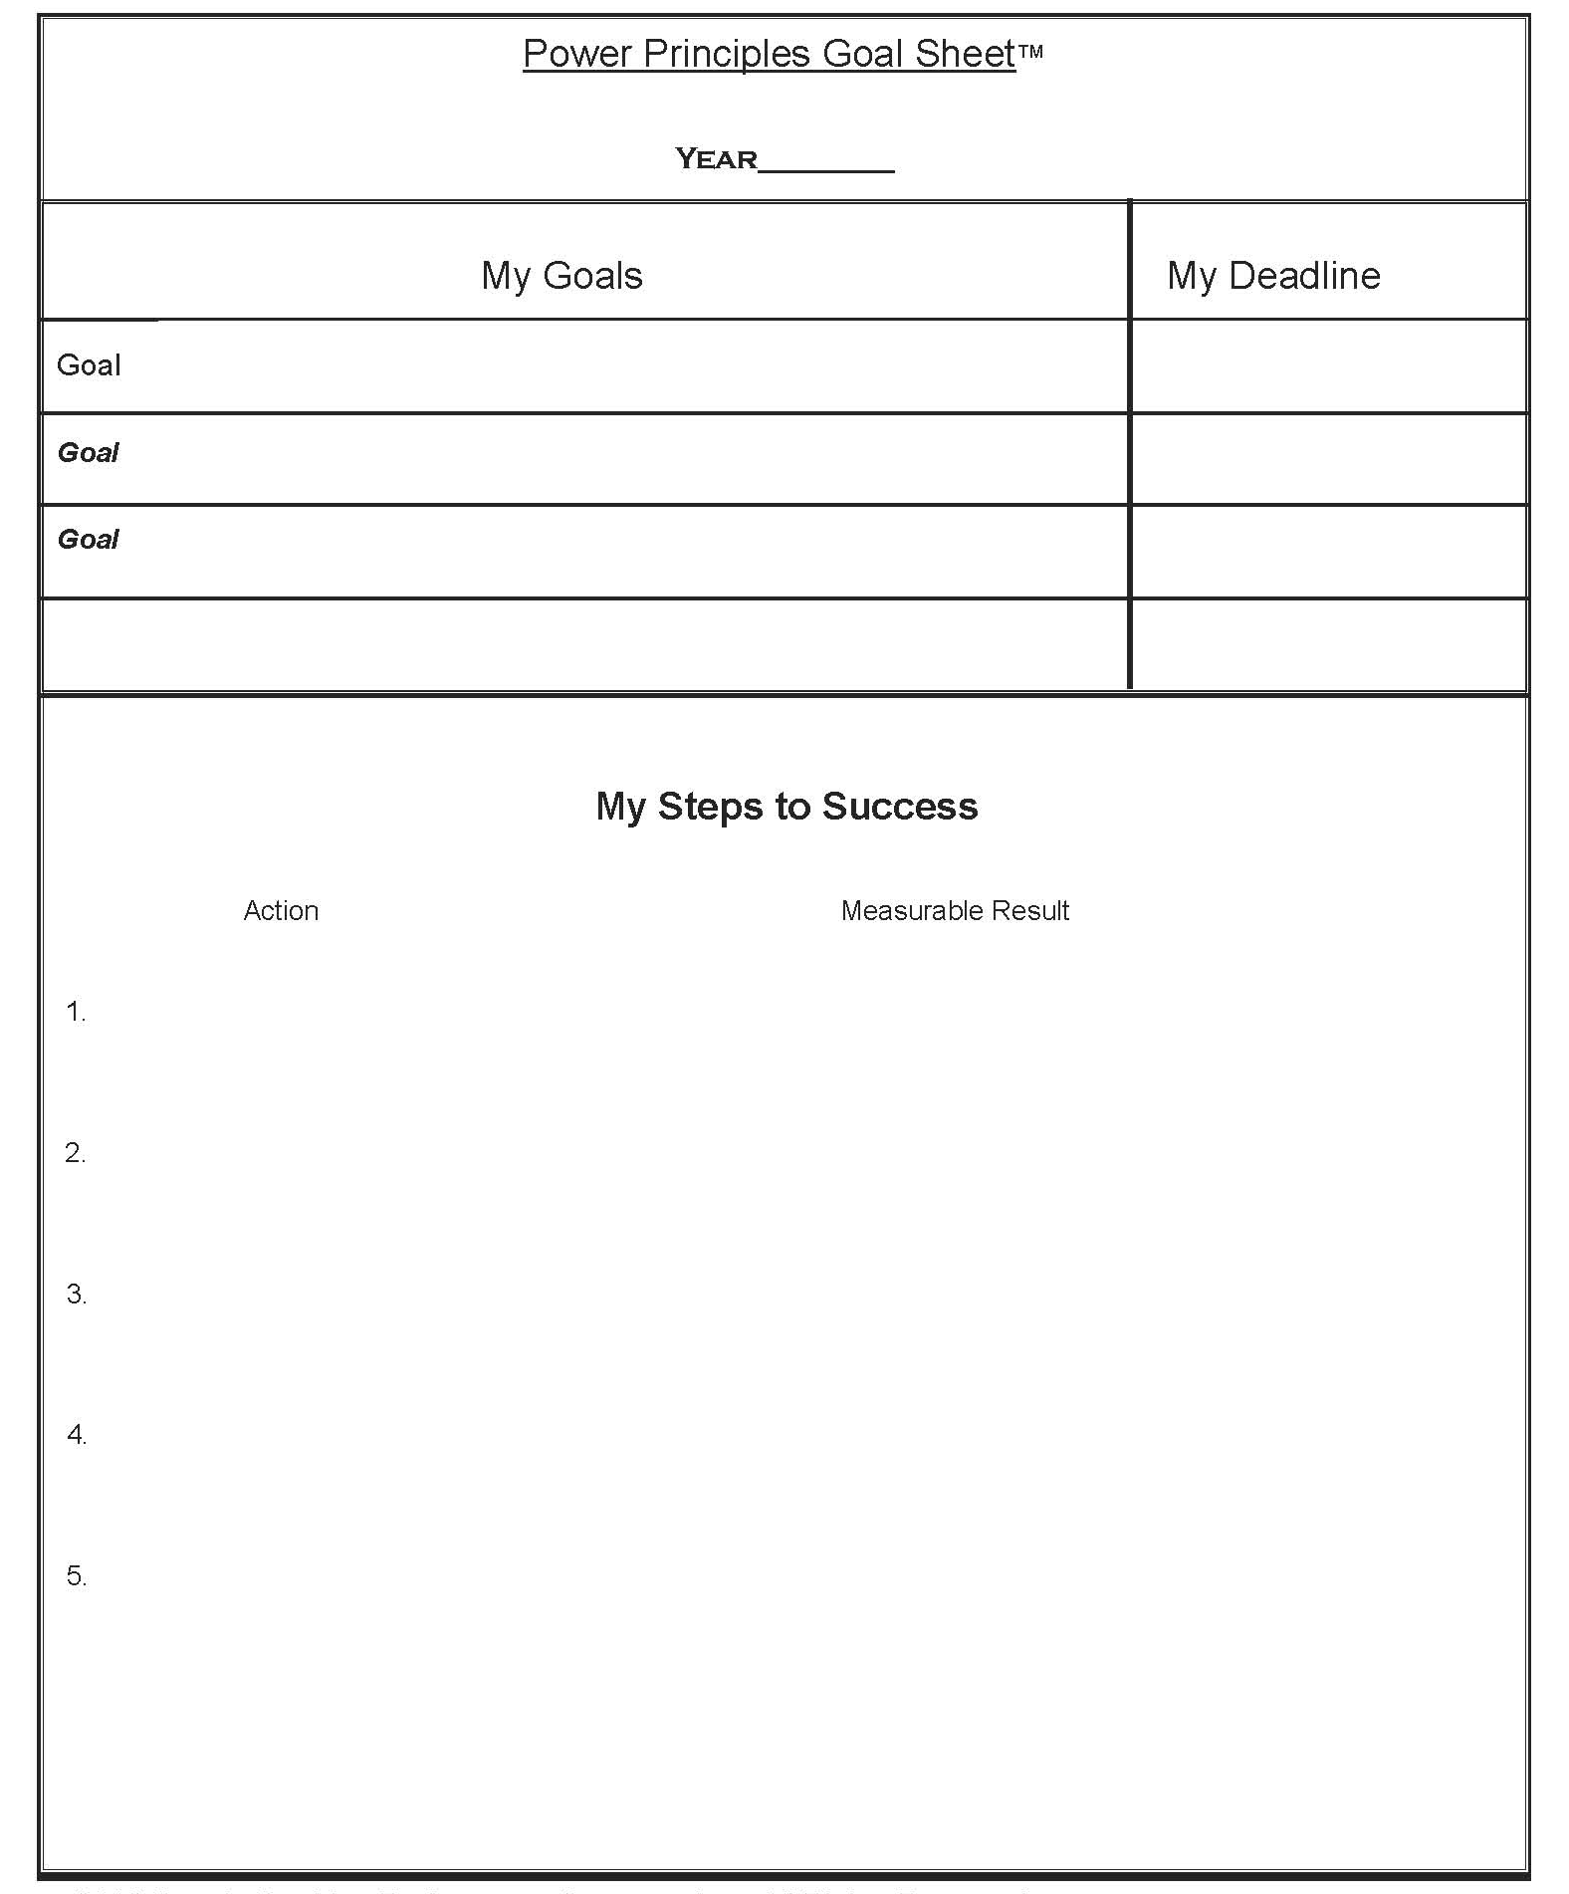
GOAL SHEET
Goal Setting
Goal Sheet

Slide 31

Goal Setting
Thank You…Now Get Started!

Slide 32

Goal Setting
This is a series of Training for your Management, Sales & Office TEAM
Good Selling !
J.W. Owens - 561-372-5922 results.jwowens@gmail.com
A Perspective 101 Series
Disclaimer: The information contained in this presentation is intended solely for your personal reference. Such information is subject to change without notice, its accuracy is not guaranteed and it may not contain all material information concerning J.W. Owens. The Company makes no representation regarding, and assumes no responsibility or liability for, the accuracy or completeness of, or any errors or omissions in, any information contained herein. In addition, the information contains white papers , presentation from others, industry material, public or shared information from others and J.W. Owens that may reflect the his current views with respect to future events and performance. This presentation does not constitute an offer or invitation to purchase or subscribe or to provide any service or advice, and no part of it shall form the basis of or be relied upon in connection with any contract, commitment or decision in relation thereto.

