Slide 1


Prospecting Strategy
Presented by J.W. Owens
A Perspective 101 Series
JWO 215
Notes:
To replace this picture, just select and delete it. Then use the Insert Picture icon to replace it with one of your own!

Slide 2
Prospecting Strategy
Day Two
We Buy from People we Like & Trust
Frequency of contact builds Name Recognition and Trust
I buy from you because “I know you, like you and trust you”.
Prospecting is making a connection and Building a Relationship.

Slide 3
Prospecting Strategy
Day Two
Who are the Best Prospects to Call On ?
Commodity Products & Services with high “Human Need” factor
High propensity to buy print advertising & do well as a result.
High probability of securing appointment
Short sales cycle, quick buying decisions, 1-3 call close.

Slide 4
Prospecting Strategy
Day Two
Newspaper
Yellow Pages
Coupon Mailers
Shoppers
Rack Publications
Direct Mail
Trade Magazines
Online
Prospects who advertise in these vehicles believe in Print media …Pre-Qualified Prospects or Warm Leads

Slide 5
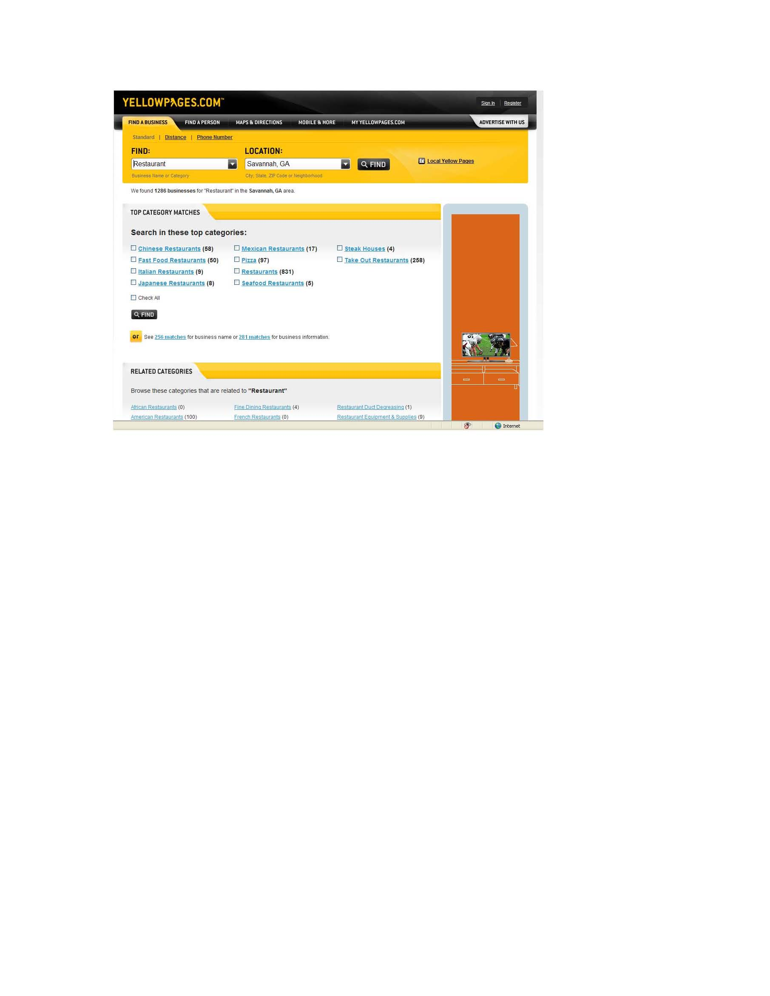
Prospecting Strategy
East way to find Business Category

Slide 6
Prospecting Strategy
Day Two
80 Calls / week (20 / day Mon-Thur)
32 Decision makers (40% of those called)
6 Set appointments (about 1 in 5 or 20%)
2 Sales (close 1 in 3 or 33% )

Slide 7
Prospecting Strategy
Best Time To Call Prospects
Day Two
Contractors / Builders Before 8:30am or after 5:00pm
Corporate Executives After 10:30am
Dentists Before 9:30am
Grocers After 10:30am
Dry Cleaners Between 10am and 4pm
Physicians Between 9 and 11:00am or after 4:00pm
Retail Stores After 10:00am
Restaurants Before 11:00am and after 2:00pm
Home Services Before 8:00am or after 4:00pm

Slide 8
Prospecting Strategy
Day Two
Remember to :
Sell the Appointment !

Slide 9
Prospecting Strategy
  Time to Prepare
  Opportunity to Present my Product
  Attentive / Receptive Audience

Slide 10
Prospecting Strategy
PROSPECTING – THE KEY TO YOUR SUCCESS!
• CHAMBERS OF COMMERCE – 1. Map of local area 2. Vinyl phone book covers 3. Chamber directories 4. Residential guide (small towns) 5. List of area churches 6. Business cards of local merchants, contractors, etc. 7. Flyers, publications 8. List of local schools 9. Welcome Wagon
• CITY HALL AND COURTHOUSE – 1. Zoning department 2. Building department (tell them you want a list of new businesses in the area or a list of new electrical turn-on’s for the past year)
• CATHOLIC CHURCHES – Visit every Catholic Church in the area and ask for a copy of the church bulletin. If church is locked, go next door to the Rectory and
get a copy from them.
• BOWLING CENTER – 1. Regular score sheets 2. Cellophane league sheets 3.
League standing board on the wall (has the sponsors of the team listed on the
weekly standings). 4. Ads on the walls, above lanes, in lounge, in a restaurant or
coffee shop, place mats with ads
• POST OFFICE – Visit the Post Office daily. Look for the junk mail, stick your nose into the garbage can that is located near the Post Office boxes to get Local FREE newspaper, etc.
• LOCAL NEWSPAPERS – Go to every newspaper in town and ask what are the
busiest days if it is a daily paper, if it’s a weekly then get the weekly editions. You
need to have at least 12 newspapers!! Last four editions and two editions from
each of the previous 4 months. Tell them that you and your brother are considering
opening a business in the area and want to see what is going on in the area. Tell
them that your brother is a BIG advertiser and ask for a Media Kit and rate card.
• FOOD STORES – Visit EVERY food store in the area. At entrance look for Bench
ads, bulletin boards, free publications, kiosks with ads, business cards, flyers.
Ask for aisle directory. Ads on shopping carts. 7. Cash register tapes.
• SPORTS FIELDS – Home run fence, scoreboard, concession stand, uniforms.
• HOTELS/MOTELS – Restaurant guides, room directories, flyers on front desk,
lounges, placemats, local maps, phone book covers, inside the rooms.
• RESTAURANTS – Placemats, coffee shops, business cards, by telephones.
• CONVENIENT / LIQUOR STORES – Food publications, Penny Saver, etc.
• DAY CARE CENTERS / RETIREMENT HOMES – Phone book covers, Senior News, etc.

Slide 11
Prospecting Strategy
• College and high school – yearbooks, school newspapers, sports programs,
book covers, student center, book store, sports fields, football-basketball calendar.
• POLICE/FIRE DEPARTMENTS – Yearbook, newsletter, calendar.
• APARTMENT COMPLEXES – The good stuff is usually near the mailboxes.
• BILLBOARDS / BENCHES/BUSES/TAXIS/TRUCK/VANS/CARS
• REAL ESTATE OFFICES – Telephone/address books, phone book covers, contractor
business cards.
• PHOTOGRAPHER – Wedding books
• FLORIST – Wedding books
• TOWN MAGAZINES – Look for them around town.
• PRINT AND FRAME SHOPS – Caricature maps, business cards, stationery.
• KNIGHTS OF COLUMBUS/JAYCEES/4-H CLUBS/BANKS – Phone book covers,
maps, newsletter, calendars.
• SIGN COMPANIES – Ask what signs they have done in the area in the past
months for new businesses.
• HEALTH CLUBS / SPAS – Look around the entrance for bulletin boards, business card displays, locker rooms.
• GOLF CLUBS – Golf scorecards, tee boxes, sponsors for the holes, locker room, league standings board, restaurant, lounge, cars and trucks in the parking lot for
contractors.
• FICTICIOUS BUSINESS LISTINGS – Legal section of the local newspapers.
DBA.
• LUMBER YARDS – Tons of local contractor business cards.
• WHOLESALE CLUBS / SELF-SERVICE LAUNDRIES / ROLLER OR ICE
SKATING RINKS / ENTERTAINMENT BOOKS.
Drive around your entire area. Look for sandwich boards announcing specials, under
new management signs, new hours signs, balloons, pennants, grand opening signs, coming soon signs.
Take a different route to your area daily – you’ll see new stuff.
Get off the main drags – that is where all the ad salespeople drive.
Prospect five to seven miles out from your office.
Remember, if you see someone who is advertising in your area, even though they may be located 15 or 20 miles from your office, call them-they want to do business with people in the area you are working with, or you would not be seeing their ads.
PROSPECTING IS THE KEY TO YOUR SUCCESS–DON’T SHORT CHANGE YOURSELF OR YOUR FAMILY!

Slide 12
The Hot 100 Categories
The Hot 100 Categories
The businesses that advertise most frequently with coupons are categorized in the following list.
CATEGORY SUGGESTED BEST OFFERS
AUTO
Car Wash Dollar off wash, multiple coupons, seasonal.
Dealer Service Free credit application, big dollars off new car, present coupon after you make your best deal.
Gasoline Service Station Any free brake checks, free tire rotation, free heating and cooling check, $1 off gas purchase of 8 or more gallons, dollars off frequently needed repairs.
General Repairs Front end alignment discount, free brake check, dollars off frequently needed service jobs.
Mufflers Any free inspection, dollars off any service work.
Oil & Lube Price point for lube, oil and filter change, dollars off.
Painting/Body Work Big dollars off or low price on paint jobs plus free estimates, $75-$100 off a paint service.
Tires List sizes and prices, seasonal specials.
Transmissions Los cost transmission tune-up and parts.
Tune-Up Dollars off or a price point offer.
.

Slide 13
The Hot 100 Categories
RESTAURANTS
Bakeries Free pastry or cookie, bogo pastry or cookie, general discount.
Barbeque See Family Style restaurants below.
Chicken General discount certificate with low minimum entry point, combo offer: bogo snack, 3 free pieces, big purchase coupon, flyers.
Chinese See Family Style Restaurants below
Donuts 50 cents or $1 off dozen, bogo holes, bogo (except donuts), no free coffee!
Family Style Bogo, dollars off, 2-fers or even price point (e.g. all you can eat buffet for $3.99).
Fine Dining Bogo (most entrees), $5-$10 off dinner for two, as few restrictions as possible.
Hamburgers Bogo, 2-fers, meal deals, low price/multiple purchases, 4-6 week expiration.
Ice Cream Two for one cone/traffic item, 50 cents off banana split, hot fudge sundae, and other items.
Italian See Family Style restaurants.
Mexican See Family Style restaurants
.
Pizza Bogo, dollars off/multiple coupons, dollars off for local pizza operator, buy one-get one at half price, 4-6 week expiration.
Pubs/Taverns Food offers, not drink offers !
Seafood See Family Style restaurants.
Subs Bogos, dollars off.
Yogurt See Ice Cream above.

Slide 14
The Hot 100 Categories
GENERAL SERVICES
Film Processing Dollars off processing, % discounts, free extra set of prints, bogo enlargements
Hair Salons $2 off cut, $5 off perm or low price, _ price kids
Maid / Cleaning Services $10 off first call, $5 off second call.
Mail and Shipping Free gift, $1 off UPS shipment and packing supplies, free mailbox rental, general discount
Nail Salons Dollars off full set of nails, free nail polish/remover
Pest Control Free estimates or inspection, dollars off, price points on specific in-season services
Pet Grooming Multiple $2 off offers on grooming, flea dip special (in-season) special price for short-haired dogs.
Photographers Free portrait 8” x 10” color, low price family portrait sitting.
Plumbing Free estimates, $10 off service call, dollars off on water, heater installation
Printing and Copying 50 free copies, bogo 500 business cards, dollars off printing services, free typesetting with printing order
Shoe Repair Dollars off on men’s and ladies’ heels and soles, general discount on other repairs
Storage Bogo month (second month free), 20% off “all you pay on move-in day”
Tanning Salons Price point for number of sessions $25 for 10), free tanning session
Television Repair Free in shop estimates, $10 off TV and VCR repair, tagline that says tape the coupon to the back of your TV, price point for VCR cleaning.
Tree Services Free estimates, dollars off tree service, stump removal.

Slide 15
The Hot 100 Categories
LEISURE
Bowling Bogo game.
Dance Studios Free registration, one month free classes, free dance bag.
Health Spas / Fitness Free month or week, three free visits, big discounts on membership.
Hotel / Motel Low price weekend getaways, dollars off, restaurant bogos.
Karate / Martial Arts Free registration, one month free classes, free uniform, dollars off on a series of classes.
Limousine Dollars off on regular service, dollars off special events (weddings), price points for prom nights, special price on airport transportation.
Travel Agencies $10 off any airline ticket purchase of $200 or more, travel survey, low-price cruises

Slide 16
The Hot 100 Categories
MEDICAL
Chiropractors Free consultation, free exam and X-rays.
Dentists Free exam and cleaning, cleaning and X-rays at a low price.
Hearing Free hearing evaluation, free hearing test, free battery check, free hearing aid cleaning, dollars off and price point offers on hearing aids.
Optical – Exams Dollars off, low price.
Optical – Glasses $13-$20 off prescription eye glasses or contacts, _ price frame, bogo frames
Pharmacies $5 off new or transferred prescription, $2 off any purchase of $5 or more, free bottle of aspirin/toothbrush, etc.
Podiatrists Free initial consultation
Veterinarians Dollars off vaccinations, free initial exam, dollars off any service, free flea dip and bath.
Day Two

Slide 17
The Hot 100 Categories
PROFESSIONAL SERVICES
Banks Free cash deposit with new checking or savings account.
Cemeteries Selling pre-need: free family record portfolio, free emergency guide, two burial spaces for low price.
Child Care Free weeks valid upon registration, free registration.
Funeral Services See Cemeteries above.
Insurance Phone quotes on auto insurance, cheap term, homeowners, free atlas, free brochure, free consultation, rate comparison table, long postcards.
Legal Services Free initial consultation.
Real Estate Free market analysis – discount on commission.
Weight Control Free consultation, % discount.

Slide 18
The Hot 100 Categories
GROCERY
Deli Bogo and dollars off on sandwiches, price point, general discount offers.
Supermarket Low prices, cents off, bogos on common items: eggs, bacon, flour, sugar, etc., flyers, free item with minimum purchase, 6-8 week expiration.

Slide 19
The Hot 100 Categories
GENERAL RETAIL
Beauty Supplies Free hairbrush, shampoo, bogos, general discount.
Bedding Free frame, free delivery, free mattress with purchase of box spring, combination of a dollar off and price point.
Card/Gift Shops Free card, free postage stamp, general discount.
Carpet Store Free doormat (carpet samples), free installation, combination price point and general discount offers.
Clothing – Family General discount certificate with low minimum entry point (below store’s average ticket).
Clothing – Women’s See Clothing – Family above.
Florist Free plant, mixed bouquet, general discount certificate, dozen roses for low price, balloons, free wire service with out-of-town orders, mention YOUR coupon with phone orders.
Framers 20% off custom framing, $10 off any purchase of $40 or more
Furniture Stores Combination price point and general discount ($100 or $300), price points on specific items.
Hardware Free key/light bulb, bogo key/light bulb, general discount certificate with low minimum entry point.
Jewelry General discount certificate in various price ranges, traffic items: ear piercing and ring cleaning, low price on gold chains.
Party Supplies General discount offer, bogo offers, freebies
Pet Shops Free fish, general discount offers, low price starter aquarium.
Shoes Individual dollars off coupons for men’s women’s and children’s shoes, no minimum entry point
Sporting Goods Multiple general discount offers, name brands, free socks
Vacuum Sales & Service Low price tune-up plus parts, bogo vacuum bags.
Video Two-for-one movies, free two or three month membership, low price for overnight rental, free popcorn.

Slide 20
Prospecting Strategy
Hi, my name is J.W.….and I could use your help.
I’ve got some important information about advertising. Who should I send it to?
Gate Keeper: Oh, that’s Mary Smith….
Is she the person who decides on this type of thing?
……and what is Mary’s title? Thank you.
……and the best time to reach her? Thank you
…....is she in now ?
I really appreciate your help. What was your name?
Thank you Susan .

Slide 21
Prospecting Strategy
Get to the Point. Tell your Prospect What He Wants to Know…..
Who are you ?
Why are you calling ?
What’s in it for me ?

Slide 22
Prospecting Strategy
What Do I Want to Know?
Does he like me (my product)?
Does he need me (my product)?
Will he see me ?

Slide 23
Prospecting Strategy
Phone Script (30 Second Commercial)
Hello…
My name is J.W. with the Moneysaver……the shopping magazine that’s direct mailed to every household in your area.
I’m calling to see if I can help you generate some new customers through direct mail.
I’d like to show you what we do for other __________ in your area.
I’m very experienced at what I do…and I make lots of money for my customers.
Would you be willing to see me for a few minutes? I promise to be short and to the point.
How about next ______ morning or _______afternoon?

Slide 24
Prospecting Strategy
What if Prospect’s Initial Reaction is Negative?
4 Most Common Responses:
  No thanks
  Not interested
  We don’t advertise
  I spent my budget

Slide 25
Prospecting Strategy
Where do I go from here ?

Slide 26
Prospecting Strategy
Get a license to proceed…
Okay, no problem…..but I’d like to keep in touch.
Can I drop off some samples of what we’re doing for other__________in your area?
I’ll show you what they do to attract new customers.

Slide 27
Prospecting Strategy
Phone Tips
To get around Gatekeeper, ask for AR or Sales
Don’t “technique” prospects. They hate it.
“If I could show you a way to increase sales by $$$ would you interested? ”
“Are you more interested in Advertising that makes you $ or costs you $ ?”
Use a script as a road map until you’re comfortable without it
Always leave your “commercial” on prospect’s voice mail.
Always leave your e-mail address on prospects voice mail.

Slide 28
Prospecting Strategy
Confirm by Fax or Email
Hello Tom,
Looking forward to our 15 minute meeting at your office next Wednesday, April 16th, 11:00 AM. See you there. Thanks a bunch!
J.W.

Slide 29
Prospecting Strategy
Confirm by Email or Fax
Hello Mr. Collins,
I redesigned the ad you are running in the Magazine.
Let’s try it in the Moneysaver and watch it pull in new new customers. Our readers buy a lot of new furniture too. (see attachment)
J.W. Owens
(Always Use an Attention Getter in Subject Line)

Slide 30
Prospecting Strategy
Dear Business Owner,
Recognizing that your time is valuable, I will be brief and to the point.
The _____________is a Powerful advertising vehicle that is generating immediate and consistent results for hundreds of businesses in ________Area.
I would like to establish a working relationship with your company by providing you help in finding new customers through Home Delivery.
Just a few reasons why using ______________ is a smart marketing strategy:
99.1% Household Penetration Hand delivered by Carriers
Targeting Choose only those zones that match your target customer profile.
Readership A huge reader audience for 25 years. Results speak for themselves.
Products Many available, including 4-color flyers, coupon books and pre-printed inserts.
Flexibility We are a weekly publication. You choose when, where& how to advertise.
Affordability A great ROI for any size budget. Prices start at less than 1 penny per household.
I would like to share some success stories from others in your industry. I will call you next week in hopes of arranging a quick meeting. I’ve enclosed something of value that I know you will enjoy reading. Thank you!
Sincerely,
J.W. Owens
By U.S. Mail

Slide 31
Prospecting Strategy
THE VISIT
Mission: - Take visual snapshot
- Gather information
- Get decision maker’s business card (E-mail)
- Sell an appointment
Do I carry - Day Timer?
- Business cards?
- Product?
- Testimonials?
- Media Kits?
- Presentation Material?
Most important - Get a license to proceed to the next step in the relationship building chain

Slide 32
Prospecting Strategy
What do we Leave Behind ?
Business Card ?
Product Samples ?
Maps ?
Rate Card ?
Media Kit ?

Slide 33
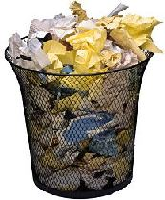
Prospecting Strategy
Day Two
What do we Leave Behind ?
Where Do Thet End Up ?

Slide 34
Prospecting Strategy
Hello John,
Let us do your prospecting for you. I make lots of money for my customers. Can we visit for just 15 minutes?
J.W.

Slide 35

Social Events
Networking Opportunities

Slide 36

Social Media
Networking Opportunities

Slide 37
Prospecting Strategy
Persistence, Commitment, Consistency !
Prospect Everyday
  120 minutes minimum
Please Don’t Quit !!!

Slide 38
Prospecting Strategy
Persistence, Commitment, Consistency !
Prospect Everyday
  120 minutes minimum
Please Don’t Quit !!!

Slide 39

Prospecting Strategy
This is a series of Training for your Management, Sales & Office TEAM
Good Selling !
J.W. Owens - 561-372-5922 results.jwowens@gmail.com
A Perspective 101 Series
Disclaimer: The information contained in this presentation is intended solely for your personal reference. Such information is subject to change without notice, its accuracy is not guaranteed and it may not contain all material information concerning J.W. Owens. The Company makes no representation regarding, and assumes no responsibility or liability for, the accuracy or completeness of, or any errors or omissions in, any information contained herein. In addition, the information contains white papers , presentation from others, industry material, public or shared information from others and J.W. Owens that may reflect the his current views with respect to future events and performance. This presentation does not constitute an offer or invitation to purchase or subscribe or to provide any service or advice, and no part of it shall form the basis of or be relied upon in connection with any contract, commitment or decision in relation thereto.

