Slide 1
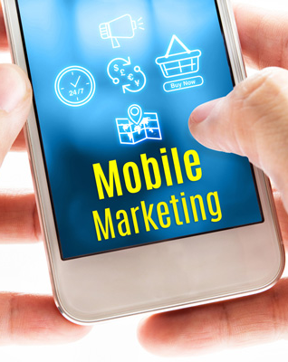
Creating Your Mobile Marketing Strategy
Presented by J.W. Owens
A Perspective 101 Series
JWO 192
Notes:
To replace this picture, just select and delete it. Then use the Insert Picture icon to replace it with one of your own!

Slide 2
Creating Your Mobile Marketing Strategy
Your customers are using mobile as an integral part of their everyday lives, and as a marketer, you need to get on board.
But, not every mobile marketing activity is going to make sense for your particular business, so you need to diligently think through your options.
For your mobile marketing channels, you might consider:
• Responsive web, email, and landing page design
• Native Mobile apps
• SMS and MMS messaging

Slide 3
Creating Your Mobile Marketing Strategy
Mobile is no longer table stakes…
Instead, it is a marketing imperative.
In order for you to communicate with your customers cross-channel and on the devices they use everyday, you must include mobile as part of your marketing strategy.
To create mobile campaigns that are effective, engaging, and relevant you need to create a strategy that makes sense for your unique business case.

Slide 4
Creating Your Mobile Marketing Strategy
CONSIDER YOUR AUDIENCE
The make-up of your audience helps determine what mobile marketing activities and channels to engage in. What make sense for one customer may not make sense for another, so keep this in mind during your planning phase.
For instance, while your persona for a 34- year-old female who shops 3 times a week exclusively on mobile applications may be a great fit for in-app promotions, your persona for a 54-year-old male who has only downloaded 5 apps on his phone may be a better fit for push notifications.
It’s important to keep these nuances in mind to determine the best way to reach and engage with your audience.

Slide 5
Creating Your Mobile Marketing Strategy
Creating Your Customer Personas
The first step to determine what mobile strategy makes sense for your audience is to create your customer personas. Most brands will have more than one. Personas are developed based on customer demographics and behavior, along with your own understanding of their motivations and challenges.
When it comes to mobile, buyer personas help you:
• Determine which mobile channel makes sense for which persona
• Determine what kind(s) of content you need to create
• Set the tone, style, and delivery strategies for your mobile messages
• Understand where your buyers get their information and how they want to consume it on a mobile platform

Slide 6
Creating Your Mobile Marketing Strategy
CONSIDER YOUR AUDIENCE
Conducting Interviews and Research
To create your personas, you should conduct interviews with customers, customer service teams, and members of your sales teams (if you have a one). You can also conduct consumer research through third party firms.
Focus on the following topics:
• Background: Basic details about your ideal customer, like age, gender, location, and so on.
• Main Sources of Information: How does your buyer consume information?
Where does she go?
Main Platforms for Gathering Information:
Does one persona get information from his phone, while another persona gets information from a tablet or laptop?
• Hobbies and Aspirations: What does your persona like to do for fun and what are her goals and aspirations? This helps you create content that is more relevant and targeted.
• Preferred Products and Stores: What type of products has your buyer purchased in the past and from where?
• App Usage: What applications does your buyer currently have on his phone? How are they used?
• Marketing Message: Write a sample marketing message for your persona(s)—this will be helpful as you craft your website, applications, advertisements, and emails.

Slide 7
Creating Your Mobile Marketing Strategy
Main Platforms for Gathering Information:
Does one persona get information from his phone, while another persona gets information from a tablet or laptop?
• Hobbies and Aspirations: What does your persona like to do for fun and what are her goals and aspirations? This helps you create content that is more relevant and targeted.
• Preferred Products and Stores: What type of products has your buyer purchased in the past and from where?
• App Usage: What applications does your buyer currently have on his phone? How are they used?
• Marketing Message: Write a sample marketing message for your persona(s)—this will be helpful as you craft your website, applications, advertisements, and emails.

Slide 8
Creating Your Mobile Marketing Strategy
CONSIDER YOUR AUDIENCE
Understand The Customer Lifecycle
Now that you’ve identified your personas, you need to create a representation of their customer lifecycle. This maps a customer’s decision-making process during the purchase phase and afterwards.
Mapping this allows you to:
Understand the process your buyers go through when engaging with your product or service
Develop a mobile strategy that speaks directly to buyers, regardless of their timing to buy.
Your personas might have various stages in their journey, but here is an example of what each stage might look like:

Slide 9
Creating Your Mobile Marketing Strategy
Passive Awareness: Your buyer is aware of your company and product, may engage with your content, but in a passive, non- active way. As an example, say you are an automobile manufacturer—a buyer in this stage is aware of who you are, but has not formally reached out and engaged.
• Active Research: Your buyer is getting ready to purchase a product that is similar to yours and is actively researching options. Using our example, a buyer in this stage has decided that she is ready to purchase a car and is researching her options.
• Trigger to Buy: Your buyer has decided that she is ready to make a purchase. For our car buyer, she is ready to make a purchase from your company.
• Feedback: You have a new customer! But now you have to make sure that you build a 2-way dialogue with her so that she becomes a repeat customer.
• Existing Customers: Once your buyer has purchased your car, you want to ensure that you maintain a relationship with her to develop brand loyalty.
• Advocates: After engaging with your customer over time, you can develop advocacy and loyalty with your customer.

Slide 10
Creating Your Mobile Marketing Strategy
DEFINE YOUR GOALS
Once you have determined your customer personas and mapped out their journeys, next you must define your goals. Creating a mobile strategy should be a holistic part of your overall company initiatives, so your goals should relate to overall business.
Set the Stage
The key to designing an effective mobile strategy is to first determine what you are doing now for mobile engagement (if anything), and then ask yourself some important questions to determine your overall goals. By asking the right questions, you can start to map out your plan.
Invite key stakeholders in the room for this initial discovery process. You may want to involve other teams in your marketing department, your sales teams, customer service teams, and other key executives.
You can start by asking yourself these key questions:
1. What are you currently doing for mobile?
This question enables you to set your baseline. Some companies may already have a variety of mobile marketing activities already in place, while other companies are not doing anything with mobile right now. Ask yourself:
a. Are you currently using responsive design in your marketing materials?
b. Do you currently have a mobile app?
c. Are you currently using push or multi-media notifications?
d. Is adding mobile marketing
a large part of future initiatives?

Slide 11
Creating Your Mobile Marketing Strategy
You can start by asking yourself these key questions:
1. What are you currently doing for mobile?
This question enables you to set your baseline. Some companies may already have a variety of mobile marketing activities already in place, while other companies are not doing anything with mobile right now. Ask yourself:
a. Are you currently using responsive design in your marketing materials?
b. Do you currently have a mobile app?
c. Are you currently using push or multi-media notifications?
d. Is adding mobile marketing a large part of future initiatives?

Slide 12
Creating Your Mobile Marketing Strategy
DEFINE YOUR GOALS
2. What are your main objectives for including mobile marketing as part of your overall marketing strategy?
Why has your company started to think about mobile and how do you think it will help you with your business objectives? Consider why you think that mobile is a critical initiative for your organization.
a. Is brand building a key objective?
b. Is gaining new customers a key objective?
c. Is relationship building with current customers a key objective?
3. Who are the key audiences you
want to target with mobile marketing?
You may have one or multiple personas that you would like to target with your mobile marketing. How different is each persona in terms of demographics? To what extent will each different persona need different messaging and mobile tactics?

Slide 13
Creating Your Mobile Marketing Strategy
DEVELOP YOUR KPIS
Once you have a good baseline to determine what you are doing now and why you want to engage in mobile marketing, you need to set your KPIs (key performance indicators) for success.
Number of app downloads
While there are a wide range of possible KPIs for mobile, you might consider the following:

Slide 14
Creating Your Mobile Marketing Strategy
Customer Engagement
One of the key reasons to embark on a mobile strategy is to engage your current customers. Your customers spend a large amount of time on mobile, so you want to make sure your mobile presence is front and center. If done correctly, you can create relationships with your customers where they are and at all times.
How is this measured?
Number of app downloads
Frequency of mobile activity
Duration of mobile activity
Participation in mobile loyalty programs
Completed customer satisfaction surveys

Slide 15
Creating Your Mobile Marketing Strategy
DEVELOP YOUR KPIS
Contact, User, and Sales Acquisition
Gaining new customers is also a key KPI for your mobile marketing strategy. By creating an engaging mobile strategy, you are likely to attract new users that convert to customers.
How is this measured?
Total number of mobile users
Contacts and new customers attributed to mobile
Spend per new mobile customer
Higher conversion rates
Closed sales connected to mobile contacts (cont.)

Slide 16
Creating Your Mobile Marketing Strategy
Customer lifetime value of mobile users
In app purchases
Service Quality
Through your mobile app, you can create a personalized relationship with your customers over time. The 24/7 nature of a mobile app lets you become closer with your customers, plus, you can provide information in your app that helps answer a customer’s question without her having to call customer service directly.
How is this measured?
Improvement in the quality of service
Lower rate of in-person interactions
Customer retention rates

Slide 17
Creating Your Mobile Marketing Strategy
MOBILE MARKETING AS PART OF YOUR OVERALL
MARKETING STRATEGY
When creating your mobile marketing strategy, do not think about mobile in isolation. Think about how it fits into your other overall marketing initiatives.
You can’t think about mobile marketing in a vacuum. You need to look at your entire marketing calendar to determine what other communications your customers receive, and from where do they receive those communications. You might be sending out emails, engaging with customers through social channels, and other cross-channel communications.
How are these interactions working in harmony? You want to deliver coordinated, relevant, customer experiences across all of the channels that your buyers use.

Slide 18
Creating Your Mobile Marketing Strategy
Communication Frequency and Relevance
How often you send customers communications, particularly email, needs
to be reconciled with your mobile strategy— especially if you are engaging in mobile notifications of any kind. You also want to ensure that all communications are in sync.
If a customer carries out an action in your app, you want to be listening to that action and responding accordingly. This is where your marketing automation platform comes in handy.
The first step is to determine your overall communication cadence. How often do you want to engage with your customers? Meet
with stakeholders in your organization to decide what this number should be. Be sure to test
and iterate over time to determine the correct number of touches based on your results.
Let’s take a look at a sample communication plan with a customer:
• Day 1: Mobile application download
• Day 1: An email thank you is sent
• Day 10: A push notification is sent
• Day 15: Website personalization offer based on persona and app usage
• Day 30: A check-in email is sent
• Day 35: Social campaign on new app features
• Day 45: An email is sent based on app usage
• Day 55: An in-app message is sent
• Day 65: Personalized ad on Facebook using targeting

Slide 19
Creating Your Mobile Marketing Strategy
The first step is to determine your overall communication cadence.
How often do you want to engage with your customers?
Meet with stakeholders in your organization to decide what this number should be.
Be sure to test and iterate over time to determine the correct number of touches based on your results.
Let’s take a look at a sample communication plan with a customer:
Day 1: Mobile application download
Day 1: An email thank you is sent
Day 10: A push notification is sent

Slide 20
Creating Your Mobile Marketing Strategy
Day 15: Website personalization offer based on persona and app usage
Day 30: A check-in email is sent
Day 35: Social campaign on new app features
Day 45: An email is sent based on app usage
Day 55: An in-app message is sent
Day 65: Personalized ad on Facebook using targeting

Slide 21
Creating Your Mobile Marketing Strategy
Marketing Calendar
You need to see all of your campaigns in one place—so you know exactly what marketing activities are taking place across all channels.
You need to track database emails, social campaigns, and your mobile campaigns at any given time.
A marketing calendar is an ideal place to ensure that you are not over-marketing to the same people with your communications.

Slide 22
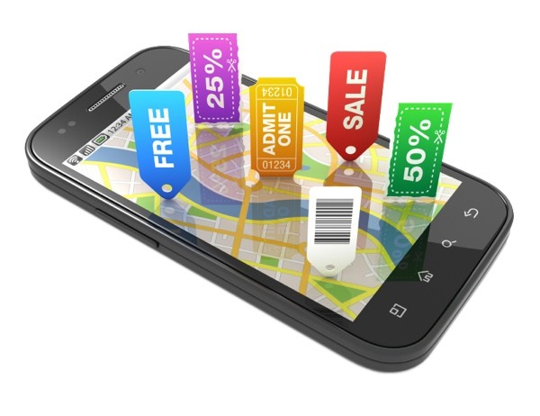
Creating Your Mobile Marketing Strategy
This is a series of Training for your Management, Sales & Office TEAM
Good Selling !
J.W. Owens - 561-372-5922 results.jwowens@gmail.com
A Perspective 101 Series
Disclaimer: The information contained in this presentation is intended solely for your personal reference. Such information is subject to change without notice, its accuracy is not guaranteed and it may not contain all material information concerning J.W. Owens. The Company makes no representation regarding, and assumes no responsibility or liability for, the accuracy or completeness of, or any errors or omissions in, any information contained herein. In addition, the information contains white papers , shared presentation from others, industry material, public or shared information from others and J.W. Owens that may reflect the his current views with respect to future events and performance. This presentation does not constitute an offer or invitation to purchase or subscribe or to provide any service or advice, and no part of it shall form the basis of or be relied upon in connection with any contract, commitment or decision in relation thereto.

