Slide 1
Customer Service Tips
Presented by J.W. Owens
A Perspective 101 Series
JWO 182
Notes:
To replace this picture, just select and delete it. Then use the Insert Picture icon to replace it with one of your own!

Slide 2
Customer Service Tips
"It is imperative that those people responsible for delivering service to customers know about every aspect of the company and the product/service range"
Keeping customers happy, ensuring that they come back in the future and encouraging them to sell the merits of your firm to their friends, relations and colleagues is an aspiration of the majority of businesses.
There are a number of ways to do this and one of the most effective of these is to provide excellent customer service. But this is easier said than done. Starting and maintaining a good relationship with customers can be a difficult task but once you get the basics right, it can make the difference between the success and failure of your business. Always remember that once a customer has lost faith in your service, it is very difficult to restore.
Here are some golden rules:

Slide 3
Customer Service Tips
Be honest
The number one rule is not to make promises to customers unless you know you can deliver upon them. Often customers come to us whenever they have already encountered problems with your product or service.
To promise to remedy the situation, say by rebooking a delivery time or saying you'll call back within the next hour, and then fail to do so will leave customers angry and dissatisfied.
If you can't solve the problem immediately, say so. Customers will tend to be more forgiving if you are honest with them.

Slide 4
Customer Service Tips
Take responsibility for problems
When there is problem, take responsibility, deal with it promptly and ensure that it is dealt with the least amount of hassle to the customer.
Be friendly and polite in your dealings with customers.
Ensure they feel valued by your business and that their complaints or views are genuinely taken into consideration.
In a telephone call, give customers a chance to air their grievances rather than talking over them.
Courtesy costs nothing and will go a long way to building up a sound and long-term relationship with customers.

Slide 5
Customer Service Tips
When dealing face to face remember that when we communicate with people:
• 7% of communication comes from the words we hear
• 38% comes from the tone of voice
• 55% comes from our body language

Slide 6
Customer Service Tips
Try to understand your customers better
The primary objective of your customer service is to resolve problems, answer enquiries and generally to make the customer's experience of buying from you as easy, clear and smooth as possible.
At another level, it is an opportunity to gain insight into the concerns and opinions of customers and, as already mentioned, a chance to tailor your product or service.
It is also a chance to sell but this must be done, if at all, sparingly and sensitively.
The long-term goal is to satisfy customers and try to ensure that they will buy from you in the future and they may not appreciate a hard sell when they have contacted you with a problem.

Slide 7
Customer Service Tips
Know everything there is to know
Dealing with customers requires knowledge of the business, the products and services, the prices, the terms and conditions, the guarantee terms, promotions and so on.
It is imperative that those actually dealing with customers know about every aspect of the company and the product/service range otherwise they will look unprofessional and illinformed.

Slide 8
Customer Service Tips
Make your products and services better
Most product innovation comes as a result of feedback from customers.
When customers regularly call to ask questions about the assembly instructions you provide with a certain product, for example, you should take this as a signal that the instructions are not adequately detailed or clear for all of your customers.
This gives you the opportunity to provide better instructions next time, improving the customer experience as you go along and reducing the number of calls you receive on that particular aspect of the service.

Slide 9
Customer Service Tips
Never lose your cool, or get angry
There's no point in getting into a heated argument with your customers where it can be avoided.
Never lose your temper and always concentrate on the resolution rather than focus on minor details of the problem.
Sometimes you may need to back down in a negotiation to retain the loyalty of your customers even when you know they are in the wrong.

Slide 10
Customer Service Tips
Don't be elusive
Make it easy for customers to get in touch with you.
Find out what ways your customers prefer to get in touch with you.
If, for example, you run an internet ordering company, you may find that the vast majority of your customer contact will be by email.
Therefore, you should ensure that you have a 'Contact Us' link on every page of the website and in a prominent position.

Slide 11
Customer Service Tips
Don't confuse your customers
Don't use jargon or try to blind your customers with science.
You will know more about the product than they do and you should seek to simplify and explain what's happening in plain, clear language.
If the customer feels he is being patronised or talked down to he will be much less likely to buy from you in the future.

Slide 12
Customer Service Tips
Understand the specifics of a complaint
Remember, before offering a solution to a problem you must fully understand what the problem is.
Asking questions and effective listening are the key skills here.
Be clear about the actions: what the customer needs to do and what you have promised to do.
Above all, take responsibility and keep the customer informed even if there is bad news.

Slide 13
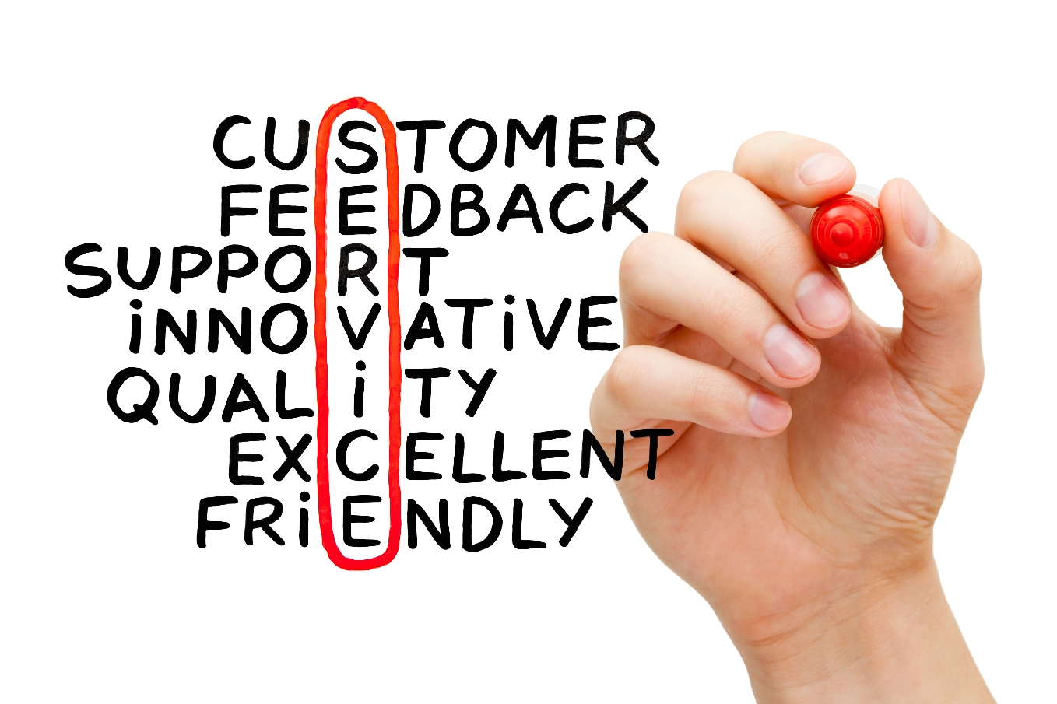
Customer Service Tips
This is a series of Training for your Management, Sales & Office TEAM
Good Selling !
J.W. Owens - 561-372-5922 results.jwowens@gmail.com
A Perspective 101 Series
Disclaimer: The information contained in this presentation is intended solely for your personal reference. Such information is subject to change without notice, its accuracy is not guaranteed and it may not contain all material information concerning J.W. Owens. The Company makes no representation regarding, and assumes no responsibility or liability for, the accuracy or completeness of, or any errors or omissions in, any information contained herein. In addition, the information contains white papers , shared presentation from others, industry material, public or shared information from others and J.W. Owens that may reflect the his current views with respect to future events and performance. This presentation does not constitute an offer or invitation to purchase or subscribe or to provide any service or advice, and no part of it shall form the basis of or be relied upon in connection with any contract, commitment or decision in relation thereto.

