Slide 1
Every Second Counts
Special Management Series
This is a series of Training for your Management TEAM
Presented by J.W. Owens
A Management Perspective 303 Series
Management - JWO 394
Notes:
To replace this picture, just select and delete it. Then use the Insert Picture icon to replace it with one of your own!

Slide 2
Every Second Counts
Every Second Counts:
Making Meeting Time Work When you pull your sales team out of the field to attend a meeting, you want every second they’re in the meeting to be put to its best and highest use.
Here’s how to keep your meetings moving:

Slide 3
Every Second Counts
1. It’s just a matter of time.
Put a time limit on each agenda item, and if it looks like the discussion is running over, quickly decide whether to table discussion, or to replace one of the other agenda items.

Slide 4
Every Second Counts
2. Start with the most critical item.
That way, even if you get nothing else done, you will have taken care of the highest priority on your list.
If an agenda item is continually pushed to a later meeting, question whether it’s necessary, or if people are procrastinating because it deals with unpleasant business.
If it’s the former, cut it from the list altogether. If it’s the latter, set a special meeting to deal with it and get it done.

Slide 5
Every Second Counts
3. Reaffirm your overall goals.
Use each meeting to remind your team of the overall goals and objectives for the team, for the quarter and the year. This doesn’t mean make a speech or ask everyone to recite the company pledge.
A simple sentence at the top of the agenda is enough to remind everyone that “this year’s goal is to double sales to our revenue.” that reaffirming goals regularly is the key to accepting them at a subconscious level.

Slide 6
Every Second Counts
4. Surprise everyone.
Do something different at each meeting – have someone else serve as facilitator or note taker. Hand out lollipops.
Give everyone a copy of a great article.
Hold your meeting at the local burger joint.
Keep everyone on their toes – it becomes a habit that carries over to all areas of your behavior, and it lets team members know that it isn’t “business as usual.”

Slide 7
Every Second Counts
5. Take time for kudos and thanks.
Public “Thank You” and “congratulations” can mean more than an in box full of email messages.
Most salespeople are extroverts – and competitive – and enjoy being patted on the back in front of others.

Slide 8
Every Second Counts
6. Follow up.
At the close of each meeting, appoint someone to be responsible for writing up action items and distributing them to attendees.
Then ask for a status report before the next meeting so you don’t waste time at the next session figuring out where everything stands.

Slide 9
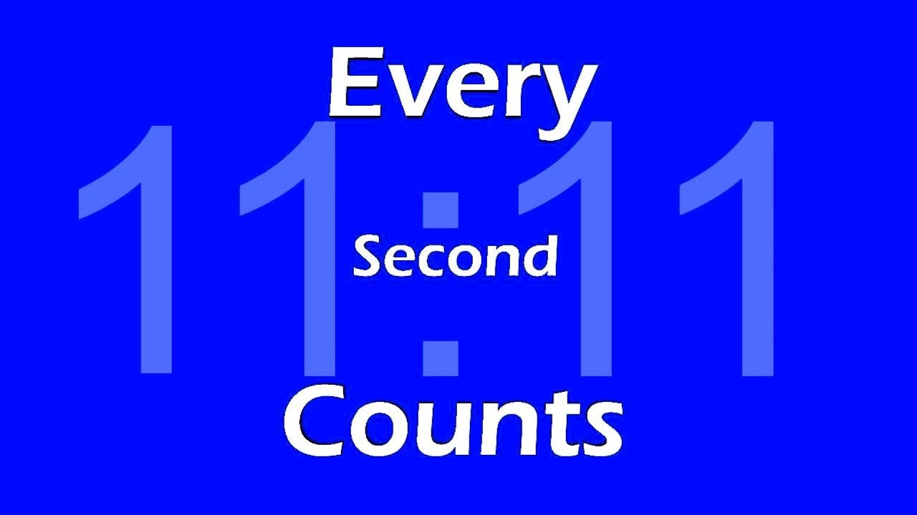
Every Second Counts
This is a series of Training for your Management TEAM
Good Selling !
J.W. Owens - 561-372-5922 results.jwowens@gmail.com
A Management Perspective 303 Series
Disclaimer: The information contained in this presentation is intended solely for your personal reference. Such information is subject to change without notice, its accuracy is not guaranteed and it may not contain all material information concerning J.W. Owens. The Company makes no representation regarding, and assumes no responsibility or liability for, the accuracy or completeness of, or any errors or omissions in, any information contained herein. In addition, the information contains white papers , shared presentation from others, industry material, public or shared information from others and J.W. Owens that may reflect the his current views with respect to future events and performance. This presentation does not constitute an offer or invitation to purchase or subscribe or to provide any service or advice, and no part of it shall form the basis of or be relied upon in connection with any contract, commitment or decision in relation thereto.

