Slide 1


THE Up Lifting
SALES TRAINING
Special Management Series
A little long but very visual for Sales People to see and a great photos and messages to use slides as an
on-going Sales Builder.
This is a series of Training for your Management TEAM
Presented by J.W. Owens
Management 303 Series
Management - JWO 330
Notes:
To replace this picture, just select and delete it. Then use the Insert Picture icon to replace it with one of your own!

Slide 2
SUCCESS HABITS
1.

Slide 3

STARTING FRESH
Start Fresh
Realize that some old habits don’t take YOU in the direction YOU want
Identify and acknowledge YOUR negative habits

Slide 4

CHOOSE AN OPPORTUNITY OR DESPAIR
Regardless of the situation, the response determines the ultimate outcome
Optimism enables YOU to create the outcome YOU desire

Slide 5

WORK WITH WHAT
YOU HAVE
Most people are endowed at birth with enough wit and common sense to achieve a certain level of success
Acquiring tools to deal with challenges, guarantees success

Slide 6

DIFFERENCE BETWEEN SUCCESS AND FAILURE
Successful people habitually do things that lead to success while failures do not
Observe the habits of successful people
Then develop those habits as a standard part of YOUR daily life

Slide 7

SUBSTITUTING VS. OMITTING HABITS
Only a habit can subdue another habit
Believe that YOU will stop being late for meetings and you will actually start being early!

Slide 8

COMMITMENT TO BUILD DAILY
The integrity of YOUR words to yourself is sacred
Stick with the job till YOU complete it
Develop a habit of committing to YOUR work, daily

Slide 9

BECOMING A NEW PERSON
Walk tall amongst men
Become a new person, believe that YOU are a new man with a new life
Though YOU may encounter obstacles in the new life, but do not let it deter YOU from working

Slide 10
LOVE
2.

Slide 11

PEOPLE’S SKILL
Love is the first of nine principles of success
YOU must have love for your profession
Sales is a people centered business hence effective people skills are the most important tools for a sales person

Slide 12

LOVE – OFFENSIVE
WEAPON
Love is the most effective weapon for conquering opposition
The aim of every sales encounter should be to gain cooperation from the prospect not destroy the sales opportunity

Slide 13
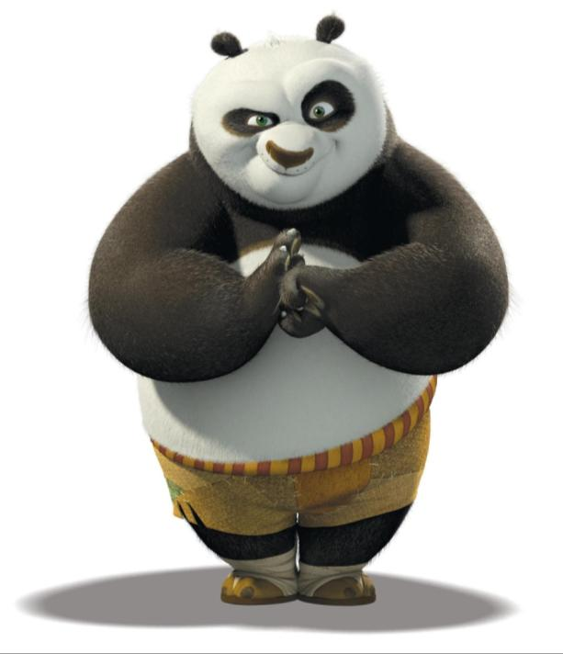
THE CONSUMER DEFENSE SYSTEM
Don’t take prospect’s excuses personally; its just an instinctive reaction
Once these same prospects begin to sense YOUR genuine concern all their defenses will start to come down

Slide 14

THE ART OF SPOTTING
HIDDEN BENEFITS
From carefully analyzing over 500 of the most successful people of their time it is discovered that one of the thing which was common in all was relentless optimism

Slide 15

PERSUASIVE POWER OF PRAISE
PERSUASIVE POWER OF PRAISE
Words have the power to sooth or to irritate
Whenever YOU use praise to highlight the good qualities in most people
People love hearing praise

Slide 16

THE CONFRONTATIONAL ATTITUDES
Approaching the people YOU meet with an attitude of love will allow YOU to disarm their defenses and make a positive first impression.

Slide 17

A PRACTICAL EXERCISE
To become a successful salesperson YOU must first be sold on what YOU are selling
Love what YOU do
Be convinced that YOUR product is of great value to the people

Slide 18
PERSISTENCE
3.

Slide 19
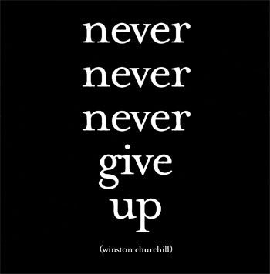

Slide 20

IMPORTANCE OF PERSISTENCE
If YOU continue to try, YOU will succeed.
Never consider defeat.
YOU will persist. YOU will win.
No great achievement has ever been attained without persistence.
Persistence is an indispensable quality of a good salesperson.

Slide 21

WORDS OF FOOLS
Remove from YOUR vocabulary the following words and phrases:
    Quit
    Cannot
    Unable
    Impossible
    Out of the question
    Failure
    Unworkable
    Hopeless

Slide 22

Keep YOUR eyes on the goal
Each failure to sell will increase YOUR chance for success at the next attempt.
Each obstacle YOU will consider as a challenge to YOUR profession.

Slide 23
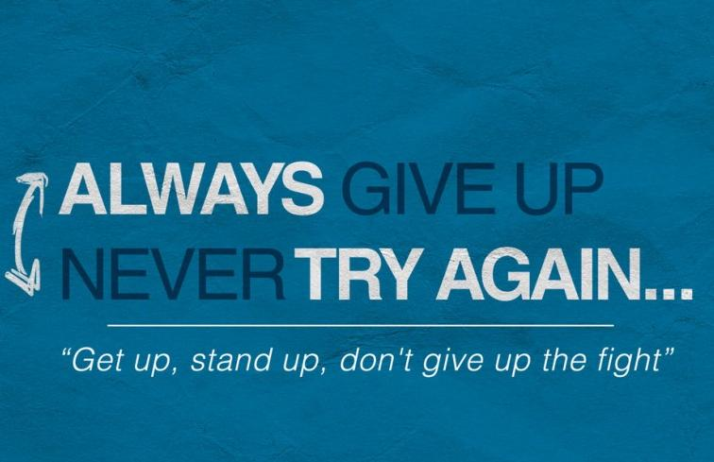

Slide 24
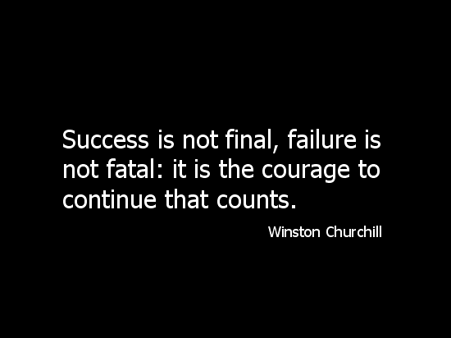
IMPORTANCE OF PERSISTENCE
YOU will learn and apply another secret of those who excel in YOUR work.
Never will YOU allow any day to end with a failure.

Slide 25
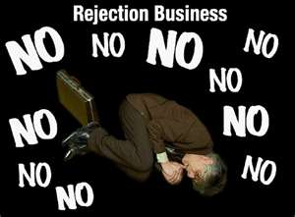
IGNORE REJECTION
Rejection is a natural by product in the sales profession.
Don’t get offended if someone declines YOUR offer.
Think of a new way to present YOUR offer so that it is more appealing.

Slide 26

TEST OF BRAVERY
Every day YOU are confronted with challenges
Each challenge is a test of YOUR bravery.
Passing the test promotes YOU to the next level of achievement and even more difficult challenges.
If YOU fail the test, repeat the lesson until YOU get it right.

Slide 27

ACCEPTING CHALLENGES
Accept the fact that YOU will be tested
Confront the tests bravely; YOU will eventually pass.
Avoiding the challenges will not make them go away.

Slide 28

BE THE LION NOT A LAMB
A lion is the most self sufficient animal, while the sheep is the most helpless
YOU must possess a fierce initiative to make things happen
Be proactive, like the lion
Take care of things yourself and just do it!
BE THE LION NOT A LAMB

Slide 29

THE SECRET OF SALES SUCCESS
A successful sales man always tries one more time
Do not walk away if a prospect has said the very first ‘NO’
Try again, or try a new prospect tomorrow

Slide 30

THE DARK SIDE OF SUCCESS
The world does not stand still, hence requires continuous progress
Strive constantly rather than living as a yesterday’s have been
Expand your dreams
Instantaneous efforts seldom produce long term benefits
Permanent results com sting efforts
Just like the hands of the clock, each movement is barely noticeable, but consistency yields lasting results

Slide 31
SELF ESTEEM
4.

Slide 32

YOU ARE UNIQUE!
YOU are nature’s greatest miracle.
YOUR uniqueness is of tremendous value
None that came before, none that live today, and none that come tomorrow can walk and talk and move and think exactly like YOU.

Slide 33

YOU ARE UNIQUE!
Elevate YOUR self esteem.
Enhance YOUR ability to unleash YOUR true potential.
When YOU begin to think highly of yourself, others will value YOU highly as well.

Slide 34

YOU ARE DIVERSE!
Highlight YOUR differences; they are what set YOU apart.
Apply this principle to the goods YOU sell.
No one has the ability to sell exactly like YOU.
Be proud of the difference
Identify the distinguishing features of YOUR product.
Uniqueness alone can be a sufficient reason for people to buy from YOU.

Slide 35

YOU ARE COMPETENT!
YOU are better equipped in both mind and body.
YOU can accomplish far more than YOU have.

Slide 36

YOU HAVE UNTAPPED POTENTIAL!
YOU have unlimited potential.
Discover new ways to unlock this unlimited potential.
YOU have the ability to solve problems that YOU have not yet encountered.
Increase YOUR own capacity to perform.

Slide 37

YOU ARE A WINNER!
YOU will win, and YOU will become a great salesman, for YOU are unique.
The self YOU display openly before the world is what determines how the world responds to YOU.

Slide 38

YOU ARE EQUIPPED WITH THE PRODUCT KNOWLEDGE
Develop sufficient product knowledge.
Enables YOU to have greater confidence in making the sales presentation.
YOUR confidence and ability to answer prospects’ questions effectively will help them to trust YOU and rely on YOUR insight.
They will be more receptive to any comments or suggestions YOU make.

Slide 39

YOU ARE A MASTER OF WORDS!
Deliver with excellence.
Words are to the salesperson what an instrument is to the musician.
Practice, improve and polish the words YOU utter to sell YOUR goods.
Deliver with excellence.

Slide 40

Are you putting your prospect to sleep?

Slide 41

Selling Skills
You should be able to sell sands to the Arabs …
In order to master the sales process, YOU must learn to master the sales presentation.
Keep in mind that telling is not selling.
Selling requires YOU to ask carefully designed questions just like a skilled lawyer.
YOU must know the answers before YOU ask the questions.
YOU must be able to anticipate YOUR prospect’s responses.
Practice YOUR presentation over and over again.

Slide 42
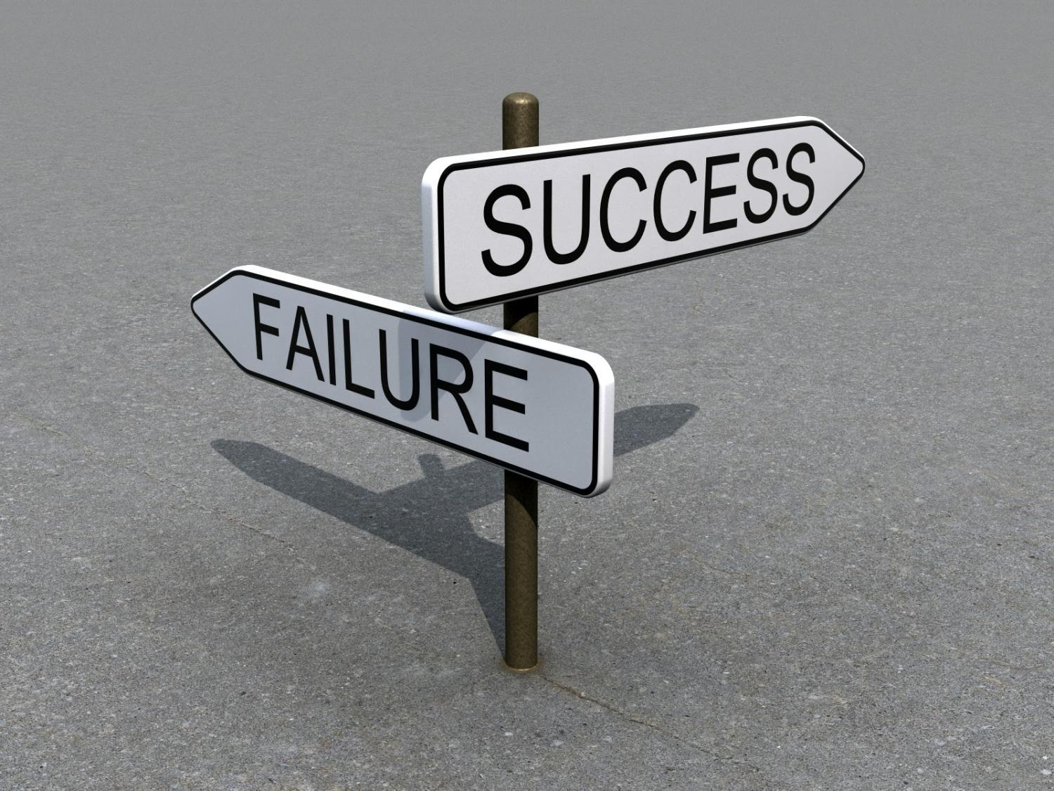
YOU CAN SEE AN OPPORTUNITY IN ALL OPPOSITIONS
All the problems and discouragements
are great opportunities in disguise.
Opposition is the fertilizer of growth.
It causes us to expand our abilities.
Look at the opposition in a way that will enable YOU to uncover the benefit it contains.

Slide 43
TIME
V.

Slide 44

Fulfill the duties of today, today!
Instead of to-do-lists, make habits
Fulfill the duties of today, today!
Instead of to-do-lists, make habits

Slide 45

LIVE IN THE PRESENT
Enjoy each day as if it’s the last…Work each day, as if it’s the last.
Anxiety is a sickness crippling daily productivity.

Slide 46

PERSPECTIVE ON YESTERDAY
Past should be reviewed just as the car’s rear view mirror
Too much emphasis on the past (rear view) will most likely result in accidents

Slide 47

Treasuring the Present
Treat present like ‘a present’
Greet each day with a positive attitude
“Look to this day, for tomorrow is only a vision and yesterday is already a dream. But if we look well to this day, we can make every tomorrow a vision of hope, and every yesterday a dream of happiness.”

Slide 48

BATTLING TIME KILLERS
Avoid the killers of time;
Procrastination
Doubt
Fear
Regrets
Worries

Slide 49

THE APPRECIATED VALUE OF TODAY
Do one extra thing a day
Growth is a universal pattern
Appreciate the value of time

Slide 50
EMOTIONS
VI.

Slide 51

YOU are the master of YOUR emotions.

Slide 52

YOU are the master of YOUR emotions.
If YOU bring gloom and pessimism to YOUR customers, they will react with gloom and darkness.
If YOU bring joy, enthusiasm, laughter and brightness to YOUR customers, they will react in the same way.

Slide 53

UNDERSTAND YOUR EMOTIONS
Understand YOUR emotions first before understanding YOUR customers’ emotions.
Negative emotions = No business
Recall YOUR failures when YOU become overconfident.
Remember YOUR moments of shame when YOU enjoy moments of greatness.

Slide 54

YOU are the master of YOUR emotions.
Become The Greatest Salesman in the World by controlling YOUR emotions.

Slide 55

THOUGHT CONTROL
Never permit YOUR thoughts to control YOUR actions.
Always use YOUR actions to control YOUR thoughts.
Never lose hope and control of yourself.

Slide 56

TOLERANCE FOR MOODY PEOPLE
Do not get offended by moody and irritable people.
This will only cause YOU to lose YOUR patience, YOUR temper and ultimately the sale.
Be understanding, patient and try to set a positive emotional tone.

Slide 57

IMMUNITY TO REJECTION
Do not take offense to rejection because it is a clear sign of personal insecurity.
Address all the objections and leave the customer with the positive impression.
Do not be afraid to cal again a person who at one time was not too receptive.

Slide 58

Action = Reaction
If Reaction = Action, try a different action

Slide 59
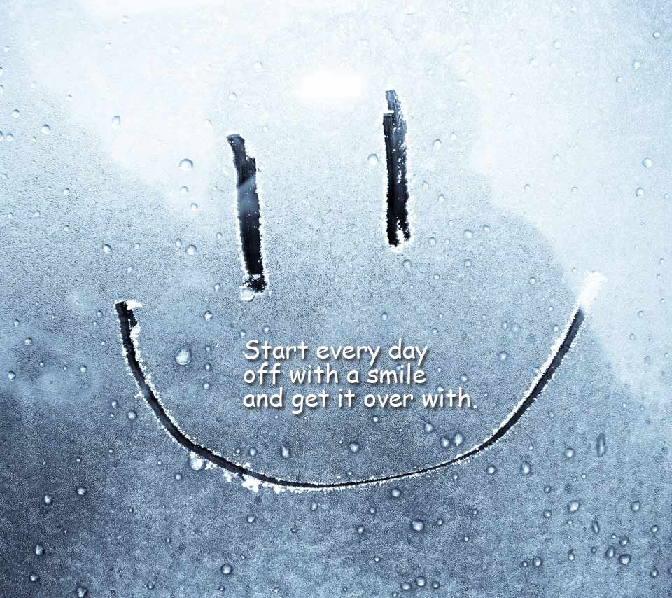

Slide 60
HUMOR
VII.

Slide 61

Believe that: this too shall pass
Enjoy today’s happiness, today!
Happiness leads to success

Slide 62

LAUGHTER EFFECTS PHYSICAL CONDITIONS
A good sense of humor frees from stress and anxiety
Positive energy and enthusiasm are a vital part of sales process, which comes through Humor

Slide 63

THE ABILITY TO LAUGH AT YOURSELF
Laughter: The best Medicine
Helps maintain the most important relationship: the one with YOU
People love happy people
Laughter is contagious

Slide 64
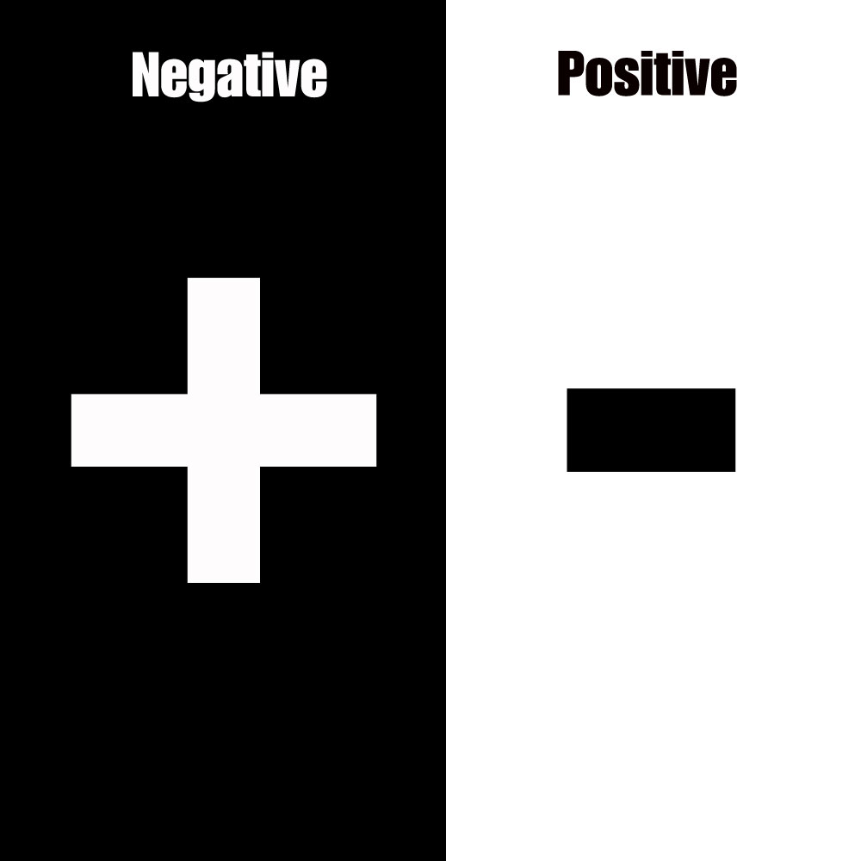
LAUGHING IN THE FACE OF ADVERSITY
Laughter removes adversity’s power
to intimidate others
Laughter can be the best revenge;
a smile can turn the world around
Laughter brings in Positivity

Slide 65

EXCHANGING SMILES FOR GOLD
Happiness given is a precious gift
People can detect insincerity
Always be genuine in YOUR transactions

Slide 66
PROGRESS
VIII.

Slide 67

GOAL SETTING
Goal setting is the most powerful personal achievement tool.
Set goals for the day, the week, the month and the year.
Set time limits for achieving the goals.

Slide 68

Never aim for too low.
Tomorrow YOU will climb higher than today.

Slide 69

DO’s
Always raise YOUR goals as soon as they are attained.
Always strive to make the next hour better than this one.
Always remember that YOU will rise when YOU stumble.

Slide 70

DON’Ts
Do not brag about YOUR accomplishments.
Do not be afraid when YOU fail to achieve YOUR goals.
Do not be afraid to declare what YOU want for YOUR future.
Do not wait for the opportunity; create the opportunity.

Slide 71
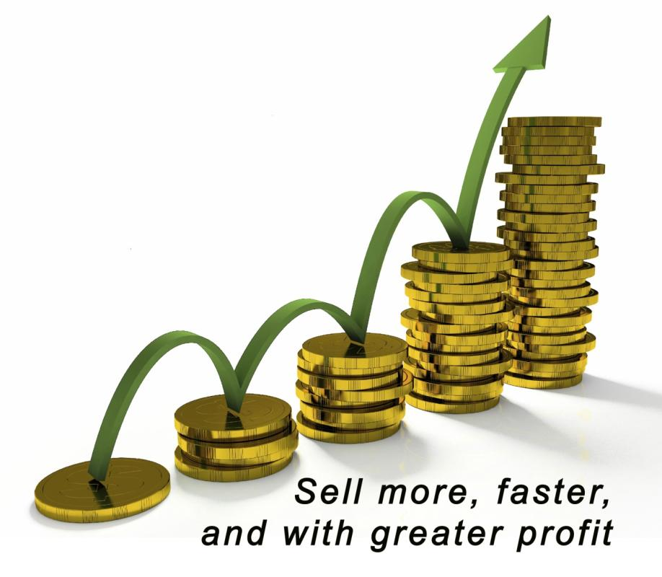
DO’s
Strive to surpass YOUR own achievements.
Develop an attitude of self satisfaction, self confidence and high self esteem.
For gauging YOUR progress, use YOUR past achievements as the starting point.

Slide 72
ACTION
IX.

Slide 73

The actions chosen make dreams a reality (Beware: that’s for nightmares too!!)
Act NOW

Slide 74

CAUSE OF PROCRASTINATION
Conquer fear; know the source of YOUR fears
Conquer YOUR thoughts
Turn undesirable thoughts into desirable ones

Slide 75

CONQUERING THE BUTTERFLIES
Develop YOUR potential to benefit others = increase YOUR value
Turn the image around in YOUR mind
Visualize positive outcomes

Slide 76

DEVELOP THE ACTION HABIT
Trigger YOUR subconscious repeatedly
Repeat to yourself: I will act NOW!!!
Don’t analyze, just act: the action will become second nature to YOU ultimately

Slide 77

HUNGER MOTIVATES YOU TO ACT
Success comes to those who thoroughly want it
Success comes if its importance is felt
Develop hunger for success, thirst for happiness and peace of mind

Slide 78
PRAYER
X.

Slide 79

Seek guidance, learn rather than achieve results

Slide 80

THE INSTINCTIVE KNOWLEDGE OF GOD
Listen to YOUR inner voice
God is a subconscious awareness
Prayer: an intensely earnest request

Slide 81

SEIZE THE OPPORTUNITY
‘Opportunity’ is in the eye of the beholder
Positive perception
Spot opportunities as soon as they pop up

Slide 82


Slide 83

PRAY TO FIND THE PATH TO SUCCESS
Accept failures as temporary (and success too!)
Slow and steady…

Slide 84


Slide 85

THE Up Lifting SALES TRAINING
This is a series of Training for your Management TEAM
Good Selling !
J.W. Owens - 561-372-5922 results.jwowens@gmail.com
A Management Perspective 303 Series
Disclaimer: The information contained in this presentation is intended solely for your personal reference. Such information is subject to change without notice, its accuracy is not guaranteed and it may not contain all material information concerning J.W. Owens. The Company makes no representation regarding, and assumes no responsibility or liability for, the accuracy or completeness of, or any errors or omissions in, any information contained herein. In addition, the information contains white papers , presentation from others, industry material, public or shared information from others and J.W. Owens that may reflect the his current views with respect to future events and performance. This presentation does not constitute an offer or invitation to purchase or subscribe or to provide any service or advice, and no part of it shall form the basis of or be relied upon in connection with any contract, commitment or decision in relation thereto.

