Slide 1
How to Conquer Common Sales Objections in 6 Steps
Special Management Series
This is a series of Training for your Management TEAM
Presented by J.W. Owens
A Management Perspective 303 Series
Management – JWO 320
Notes:
To replace this picture, just select and delete it. Then use the Insert Picture icon to replace it with one of your own!

Slide 2
How to Conquer Common Sales Objections in 6 Steps
Are members of your sales team having trouble closing deals because of the objections your prospects raise?
Objections are a natural part of the sales process.
When you and the prospect are taking the steps
to move forward in the sales process it’s natural that objections will arise.
They are questions about whether it’s a fit, it will work, it’s affordable, valuable and if it’s the right choice.

Slide 3
How to Conquer Common Sales Objections in 6 Steps
What are Objections?
Objections usually arise because either you or the prospect don’t have a full understanding of something important. People want to feel good about their purchases whether business or personal. They want to be sure they made the right decision. So sometimes an objection is really the prospect saying, “Tell me why your product is so great, so I can feel good about my purchase.”
Most objections are legitimate and should be treated that way. Many salespeople talk about having to overcome objections. I always use the term “handle” instead. If I have an objection, I don’t want to “overcome.” I want to know how you will handle that objection and make sure the purchase is a good solution for me.
As a prospect, this will tell me a lot about how you will respond in the future if I become a customer.

Slide 4
How to Conquer Common Sales Objections in 6 Steps
4 Categories of Objections
Objections usually fall into one of 4 categories: price, timing, product or something the prospect will not disclose to you. The 4th is something like,
“My brother sells the same product and I need three quotes but I’m going to buy from him.” Or,
“I don’t like you, but I’m not going to tell you that so I will throw out some other objections.”
No doubt, you have come across all the common objections; the next step is to make sure you have a process for handling them.

Slide 5
How to Conquer Common Sales Objections in 6 Steps
4 Categories of Objections
Objections usually fall into one of 4 categories: price, timing, product or something the prospect will not disclose to you. The 4th is something like, “My brother sells the same product and I need three quotes but I’m going to buy from him.” Or, “I don’t like you, but I’m not going to tell you that so I will throw out some other objections.”
No doubt, you have come across all the common objections; the next step is to make sure you have a process for handling them.
The following exercise will help you:
Make a list of the objections you commonly hear.
Write several solutions that are appropriate for those objections.
Craft questions that will help you understand the objections.

Slide 6
How to Conquer Common Sales Objections in 6 Steps
The following exercise will help you:
Make a list of the objections you commonly hear.
Write several solutions that are appropriate for those objections.
Craft questions that will help you understand the objections.
Here’s an Example:
Objection: The price is too high.
Possible solutions: Provide financing, develop a payment plan, explain the return on investment, help them work it into the next budget, discuss the value.

Slide 7
How to Conquer Common Sales Objections in 6 Steps
Possible questions
(you wouldn’t ask all of them):
What have you discovered in comparing our product to the competition?
How much were you planning on spending?
What is your budget for this purchase?
Would financing make the purchase possible?
What features and benefits would make the price work for you?

Slide 8
How to Conquer Common Sales Objections in 6 Steps
Don’t Get Stuck on Price
Price may be the most frequent objection, but it is only one type of objection and often a price objection masks other types of objections.
Prospects will have objections about timing, features, service, shipping and a myriad of other things but sometimes instead of explaining those to you, they object to the price.
Being prepared and asking good questions helps you get past the price objection.

Slide 9
How to Conquer Common Sales Objections in 6 Steps
Be Prepared
Handling objections is something you will always need to be prepared to do.
New objections come up, but typically we hear the same objections and need to come up with good solutions to handle those.
It is good to do the above workshop several times a year and remember to use the process for handling objections below.

Slide 10
How to Conquer Common Sales Objections in 6 Steps
6 Steps for Handling Objections
Listen: Listen carefully to the objection.
Validate: Make a statement of validation to show you listened.
Ask: Confirm your understanding of the objection by asking a clarifying question.
Solve: Answer objections with the appropriate solution.
Confirm: Confirm that your solution covers their objection.
Move on: If the customer is open to the solution move on to the next step in the sales process.

Slide 11
How to Conquer Common Sales Objections in 6 Steps
Most salespeople skip from step 1 to step 4.
This often leads to them offering the wrong solution and getting another objection.
Use all 6 steps to be sure the prospect is satisfied that you can handle their business and deliver what you promise.

Slide 12
How to Conquer Common Sales Objections in 6 Steps
In conclusion, handling objections is something you need to review with your team frequently.
Your team should be able to handle objections with ease. If they use the 6 steps, not only will it be easier, they will provide the right solutions, making the prospect feel confident and the sale will progress more quickly.
Objections are a natural part of the sales process.
Prepare your team to be naturals at handling them.

Slide 13
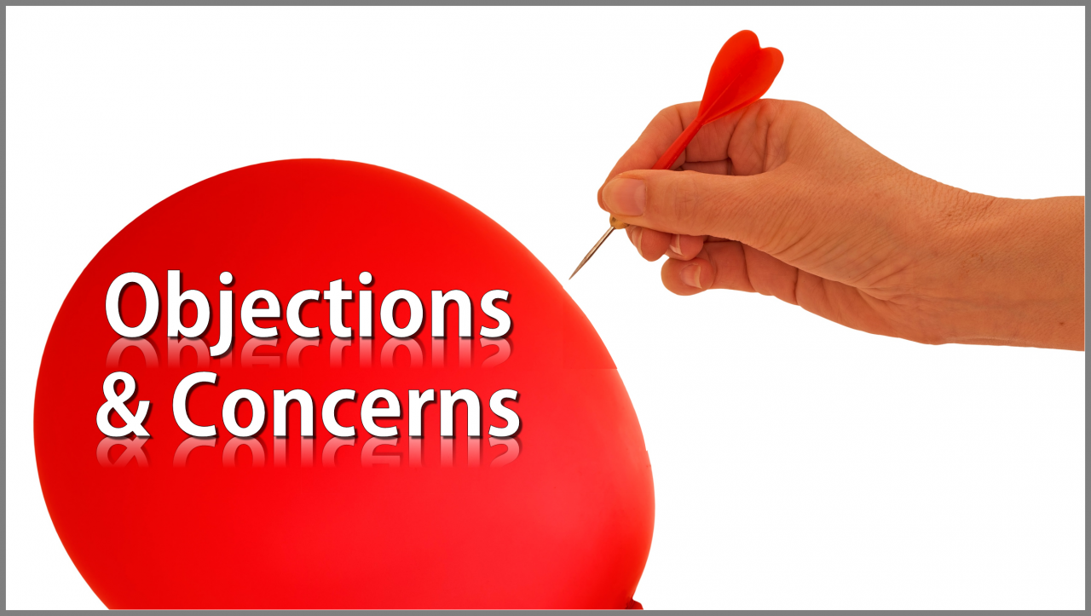
How to Conquer Common Sales Objections in 6 Steps
This is a series of Training for your Management TEAM
Good Selling !
J.W. Owens - 561-372-5922 results.jwowens@gmail.com
A Management Perspective 303 Series
Disclaimer: The information contained in this presentation is intended solely for your personal reference. Such information is subject to change without notice, its accuracy is not guaranteed and it may not contain all material information concerning J.W. Owens. The Company makes no representation regarding, and assumes no responsibility or liability for, the accuracy or completeness of, or any errors or omissions in, any information contained herein. In addition, the information contains white papers , shared presentation from others, industry material, public or shared information from others and J.W. Owens that may reflect the his current views with respect to future events and performance. This presentation does not constitute an offer or invitation to purchase or subscribe or to provide any service or advice, and no part of it shall form the basis of or be relied upon in connection with any contract, commitment or decision in relation thereto.

