Slide 1
Time Management Checklist
Special Management Series
This is a series of Training for your Management TEAM
Presented by J.W. Owens
A Management Perspective 303 Series
Management – JWO 308
Notes:
To replace this picture, just select and delete it. Then use the Insert Picture icon to replace it with one of your own!

Slide 2
Time Management Checklist
Organize your time…
the money hours
Organize your day around the money hours-- the hours you can and should be talking with prospects and customers
non-revenue generating activities are before or after the money hours

Slide 3
Time Management Checklist
Organize your time…
Prospecting Hours
Dedicate a certain percentage of money hours to prospecting
Vary the time of day you prospect to increase the probability of reaching prospects
schedule it, do it, love it

Slide 4
Time Management Checklist
Organize your time…
Follow Up
Queue up and standardize your most frequently used follow-up pieces for easy production and distribution
Document follow up immediately-- do not set aside to document later

Slide 5
Time Management Checklist
Organize your time…
Professional Development
Schedule non-money hours for sales skill development or improving industry and/ or product knowledge

Slide 6
Time Management Checklist
Organize your time…
Understand the value of your time…

Slide 7
Time Management Checklist
Organize your time…
Sales Days
Be aware of the sales days for each month and quarter
Know where you are in the sales timeline and plan accordingly
Download the sales day calendar

Slide 8
Time Management Checklist
Organize your time…
Sales Stats
Understand and track your sales stats so you may plan effectively
Dials to contacts
Contacts to qualified leads
Qualified leads to proposals
Proposals to contracts
Contracts to customers
Calls or dials per hour
Follow up calls per hour
Follow up attempts before dropping

Slide 9
Time Management Checklist
…extra time
Choose a reasonable extra amount of time to dedicate to sales each day
(23 minutes each sales day adds one extra sales day each month)

Slide 10
Time Management Checklist
…Productive Down Time
Always have something to read… always… for flight delays, waiting rooms and lines
Use drive time for sales development and phone calls
(get a headset if you can)

Slide 11
Time Management Checklist
…the extra call
One extra call a day is more than
250 extra contacts in a year

Slide 12
Time Management Checklist
Remember time management basics…
Start Early
not only for the day, but also for the week, month and quarter
start early on projects and sales appointments

Slide 13
Time Management Checklist
Remember time management basics…
Plan Ahead
Understand time for the month, week and quarter
Look ahead to sales days around holidays, end of the month and end of the quarter and plan accordingly
Be aware of the sales "timeline" for your product-- where you are in the month and where you are with the prospect

Slide 14
Time Management Checklist
Remember time management basics…
Prepare Yourself
You're a sales professional-- prepare yourself for sales greatness with the sales checklist tool

Slide 15
Time Management Checklist
Remember time management basics…
Respect Time
Your time, your prospect's time, and customer's time
Professionals don't waste time and prospects and customers respect those who understand this…
be punctual

Slide 16
Time Management Checklist
tic toc…
Now Go Sell Something

Slide 17
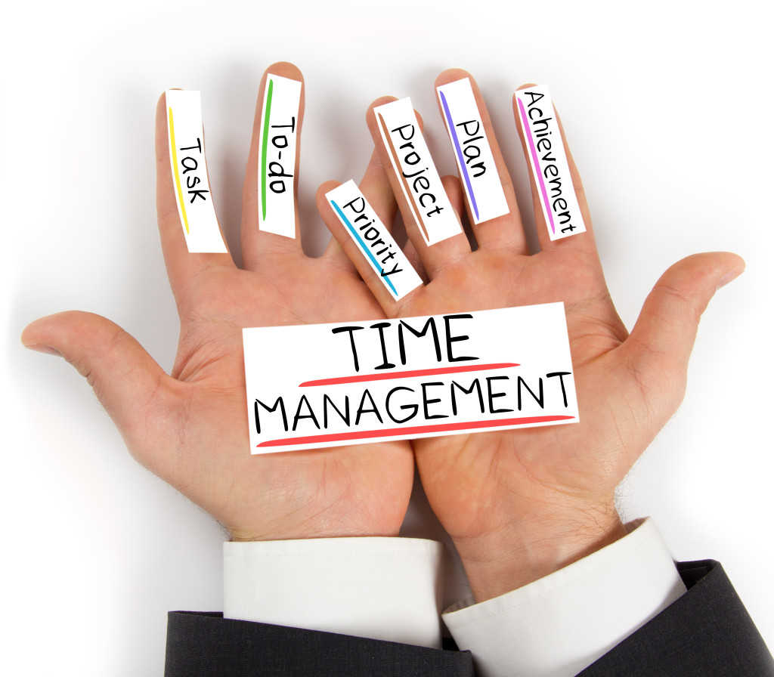
Time Management Checklist
This is a series of Training for your Management TEAM
Good Selling !
J.W. Owens - 561-372-5922 results.jwowens@gmail.com
A Management Perspective 303 Series
Disclaimer: The information contained in this presentation is intended solely for your personal reference. Such information is subject to change without notice, its accuracy is not guaranteed and it may not contain all material information concerning J.W. Owens. The Company makes no representation regarding, and assumes no responsibility or liability for, the accuracy or completeness of, or any errors or omissions in, any information contained herein. In addition, the information contains white papers , shared presentation from others, industry material, public or shared information from others and J.W. Owens that may reflect the his current views with respect to future events and performance. This presentation does not constitute an offer or invitation to purchase or subscribe or to provide any service or advice, and no part of it shall form the basis of or be relied upon in connection with any contract, commitment or decision in relation thereto.

